Slide 1
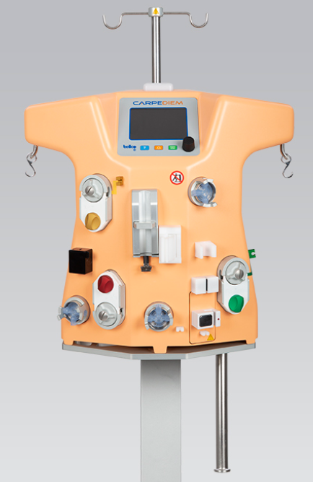
Carpediem™
Cardio-Renal Pediatric Dialysis
Emergency System
  Machine overview, components, disposables and consumables
  resource
  June 2020

Slide 2
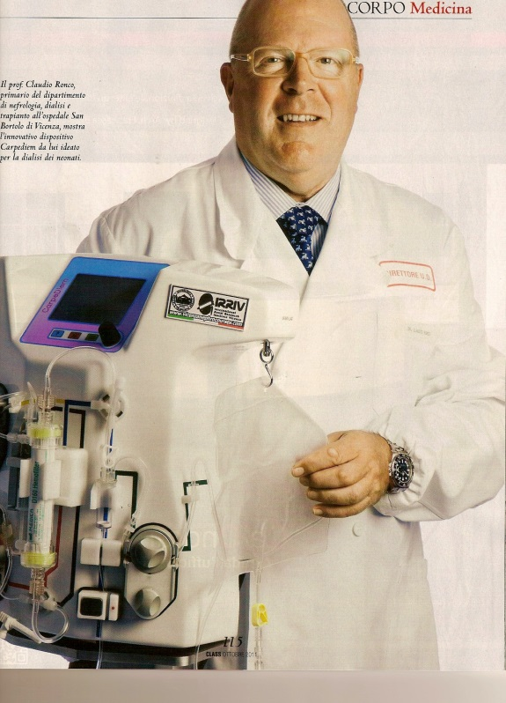
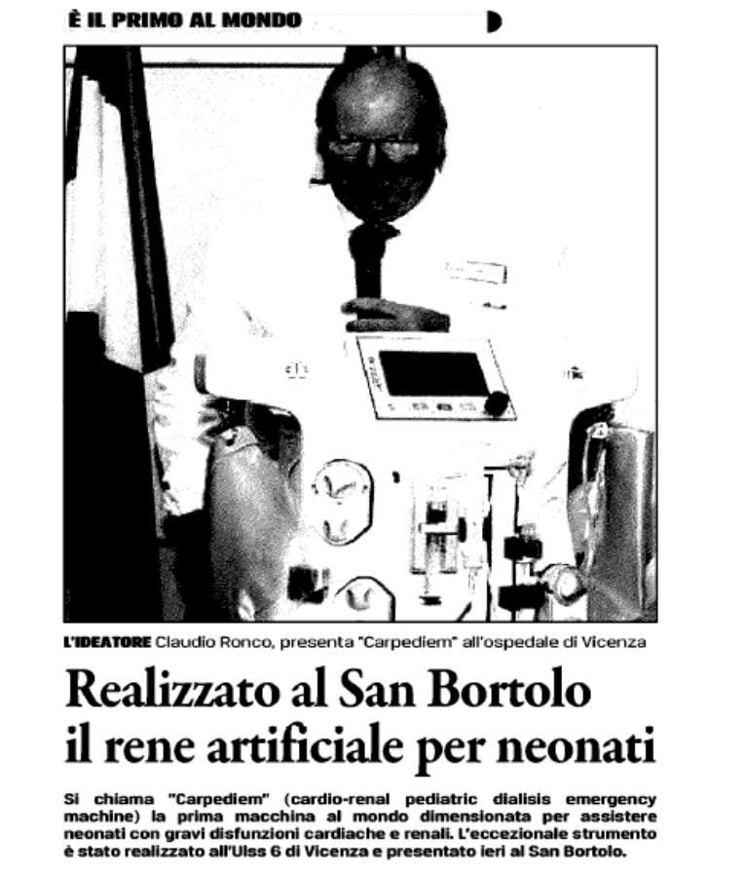

2012 first in the world
Prof. Claudio Ronco Vincenza Italy

Slide 3
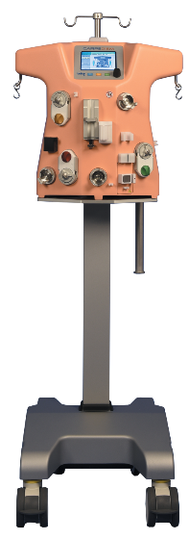
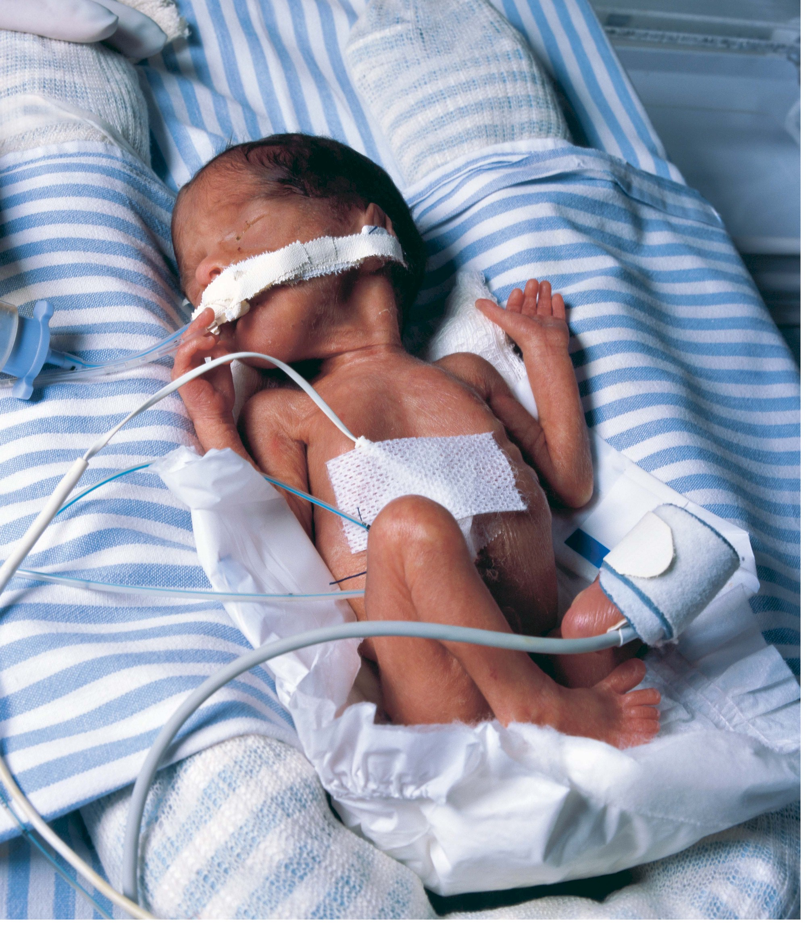
Carpediem™ Pediatric Dialysis system
Overview
Indicated in acute kidney injury or fluid overloaded patients requiring hemodialysis or hemofiltration therapy
The Carpediem™ system is capable of performing ultrafiltration, hemofiltration and hemodialysis
Intended to provide continuous renal replacement therapy (CRRT) for pediatric patients weighing between 2.5-10 kilograms (5.5 lbs–22 lbs)
Special miniaturized components ensure high accuracy in weight loss and pump flows
Dedicated Single-use kits support low priming volumes
Overview | Components | Disposables & consumables
Notes:
.

Slide 4
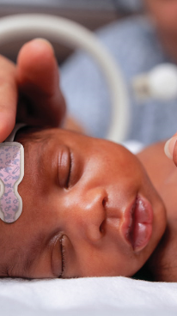
Carpediem™ Pediatric Dialysis
system
TREATMENT OPTIONS
SCUF: Slow Continuous Ultrafiltration
CVVH: Continuous Veno-Venous Hemofiltration
      Pre dilution (pre dialyzer)
      Post dilution (post dialyzer)
CVVHD: Continuous Veno-Venous Hemodialysis
Both preassembled device models may be used to deliver SCUF, CVVH and CVVHD
Overview | Components | Disposables & consumables

Slide 5
components

Slide 6
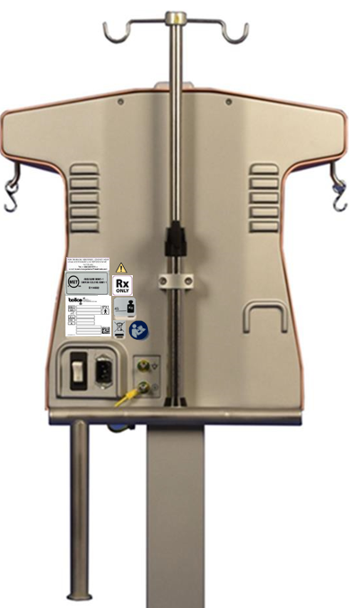
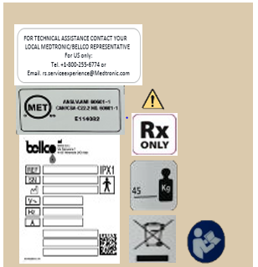
Carpediem™ system components
Back View and cords
Labels
Power supply plug
Potential equalizer
point
Mains ON (‘I’)/
OFF (‘O’) switch
Protection ground connector
Warmer holder
Base plate
Overview | Components | Disposables & consumables

Slide 7
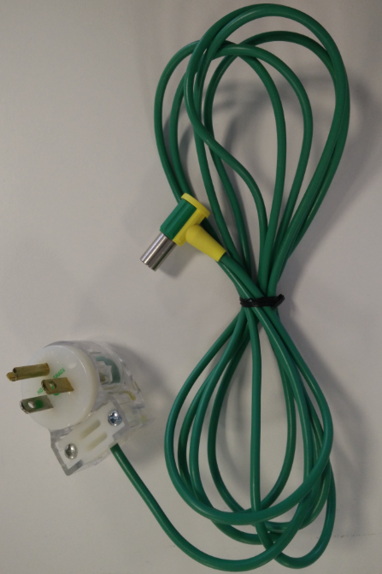
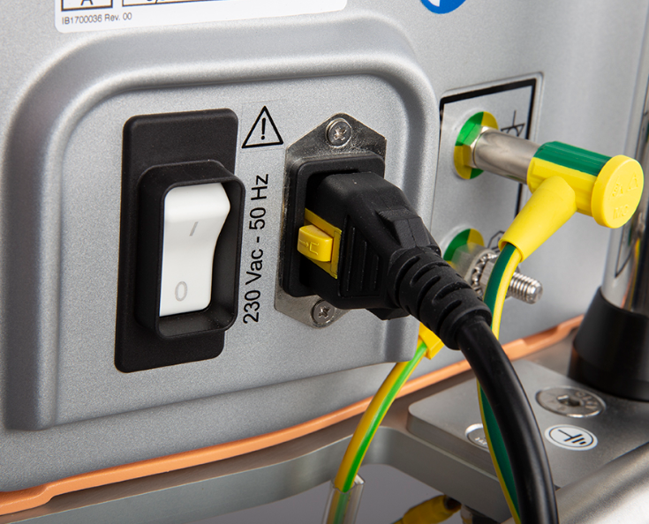
Carpediem™ system components
Cords and power
Note: When using a CVC access for treatment (with a tip in the right atrium), the use of the equipotential cable is mandatory.
The cord must be connected to the machine and then connected/plugged into a grounded electrical hospital socket
Equipotential cord
Overview | Components | Disposables & consumables

Slide 8
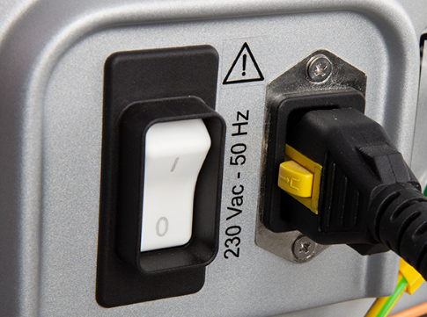

Carpediem™ system components
Battery
Remove cord
Stores data for 2 minutes
Not designed to run a therapy
Battery check/test recommend prior to treatment:
  If NO alarm, recharge battery by plugging into power socket
  If alarm 21 BATTERY DEAD presents, RECHARGE before use
WARNING: Battery should be recharged ONCE A MONTH for at least 8 hours . Refer to Carpediem™ Operators Manual for further information
Overview | Components | Disposables & consumables

Slide 9
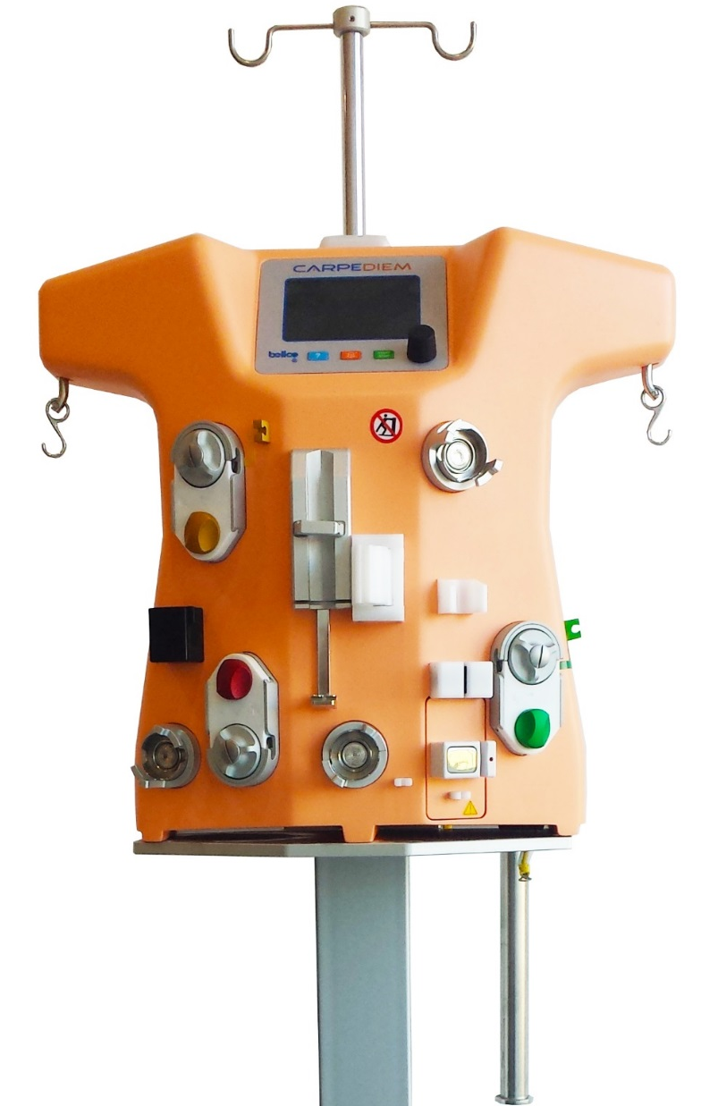
Carpediem™ system components
Front view
IV pole holder
Warning light
Control panel
Infusion/dialysis (INF/DIA) scale
Effluent (EFF) scale
Venous pressure transducer (Dome)
Clip for effluent pump segment
Effluent pump
Filter holder
Heparin pump
Venous drip chamber holder
Blood leakage detector (BLD)
Clip for infusion/dialysis pump segment
Blood pump
Infusion/dialysis (INF/DIA) pump
Air sensor
Arterial pressure transducer (Dome)
Venous electroclamp
Pre-filter pressure transducer (Dome)
Clip for venous line
Clip for infusion/dialysis line if a warmer is used
05-2019 CARPEDIEM REV. 01 AUTHOR: SILVIA MANFREDINI
Warmer holder
Overview | Components | Disposables & consumables

Slide 10
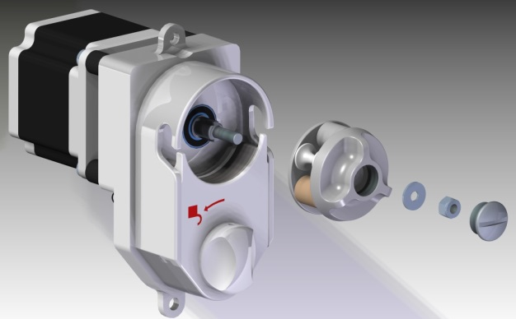
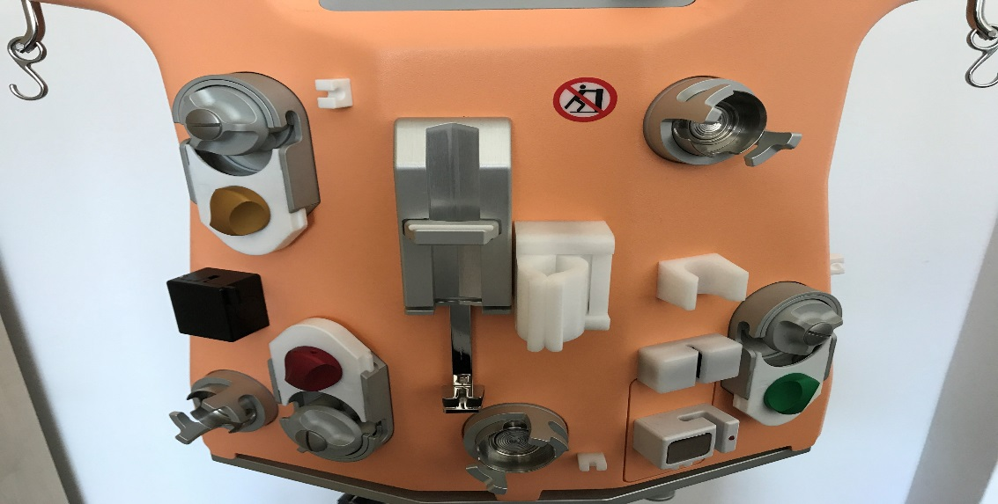
Carpediem™ system components
Inside the Carpediem machine
All parts designed to:
Increase miniaturization
Reduce priming volume
Reduce circuit pressure
Overview | Components | Disposables & consumables

Slide 11
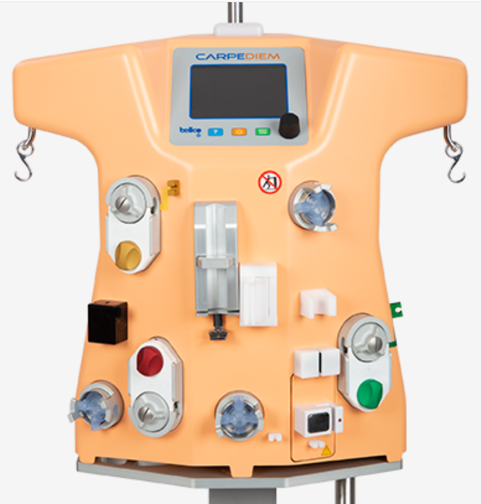
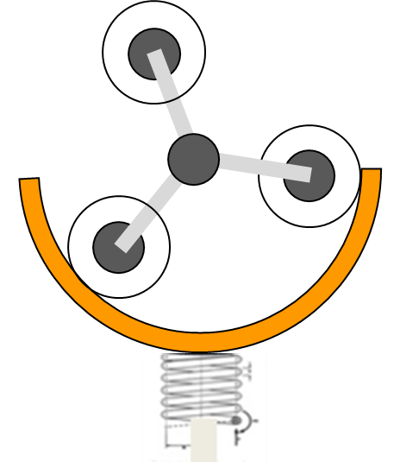
Carpediem™ system Components
High performance pumps
3 micronized peristaltic pumps:
    Blood pump
    Effluent pump
    Infusion/dialysate pump
Each pump is equipped with 3 rollers to maximize delivery precision
Effluent pump
Infusion/
Dialysis
pump
Blood pump
Peristaltic pump utilizes the movement of the stator to increase miniaturization
Overview | Components | Disposables & consumables

Slide 12
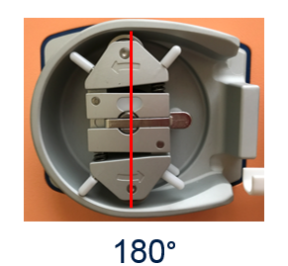
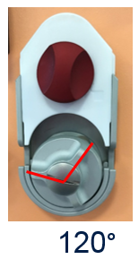
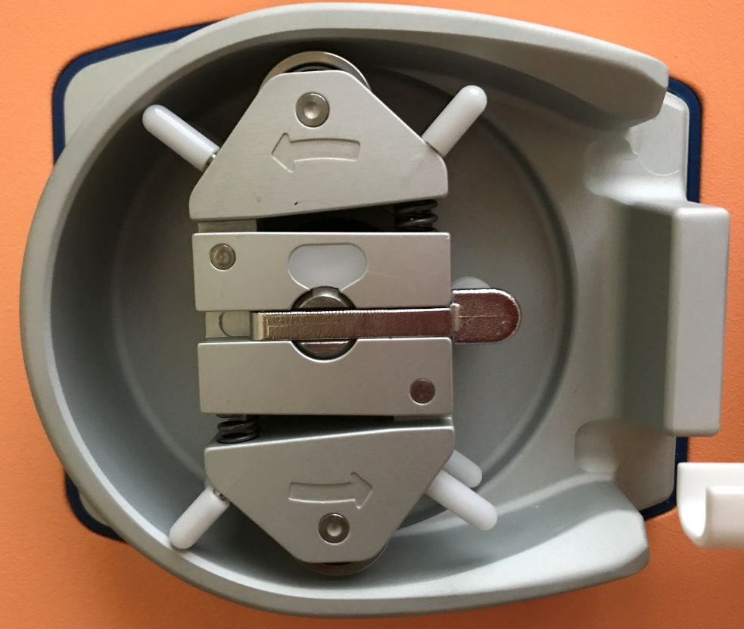
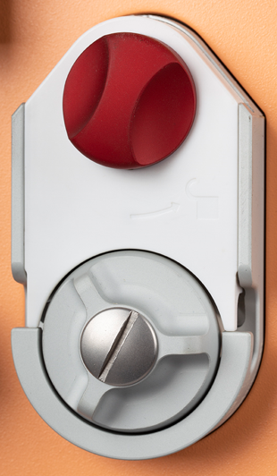
Carpediem™ system Components
Efficiency pumps
VS
Miniaturization considerations
  Occlusion
  Pressure peaks
  Filling volume
Overview | Components | Disposables & consumables

Slide 13
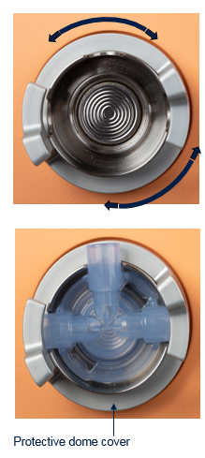
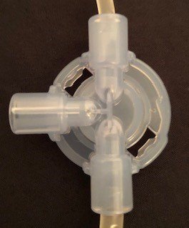
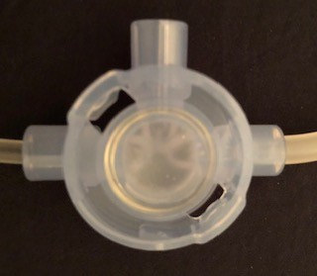
Carpediem™ system components
Pressure Sensor transducers
3 unique pressure transducers (Dome):
  Arterial
  Prefilter
  Venous
Protective dome covers prevent damage to the pressure transducer domes
Locking mechanism holds tubing in place
Each pressure transducer is linked to a pump
Membrane
Pressure dome- front
Pressure dome-back
Overview | Components | Disposables & consumables

Slide 14
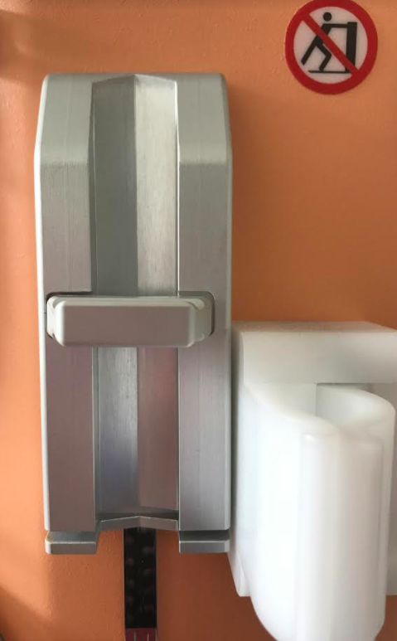
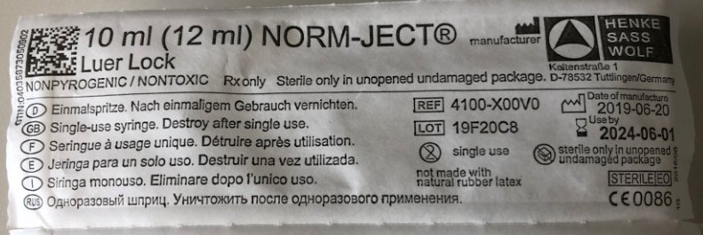

Carpediem™ system Components
HEPARIN OPPERATING RANGES and SYRINGE
Bolus: 0.1 to 3 mL – resolution (increments) of 0.1 mL
Continuous: 0.4 to 20 mL/h – resolution (increments) of 0.1 mL
Single-use 10 mL syringe is provided in the Single-use Kit
Note:
ONLY the validated 10 mL syringe provided in the Single-use kit can be used with the Carpediem™ system
ONLY Heparin has been validated for use with Carpediem™ system
Overview | Components | Disposables & consumables

Slide 15

Carpediem™ system components
Safety
The system limits the convective rate to 20% of the blood flow recognizing the type of hemofilter thus preventing excessive hemoconcentration
The system recognizes the type of preassembled device and delivers the appropriate volume during blood restitution
Weight loss accuracy is limited to + 30g per 24 hrs.
Overview | Components | Disposables & consumables

Slide 16
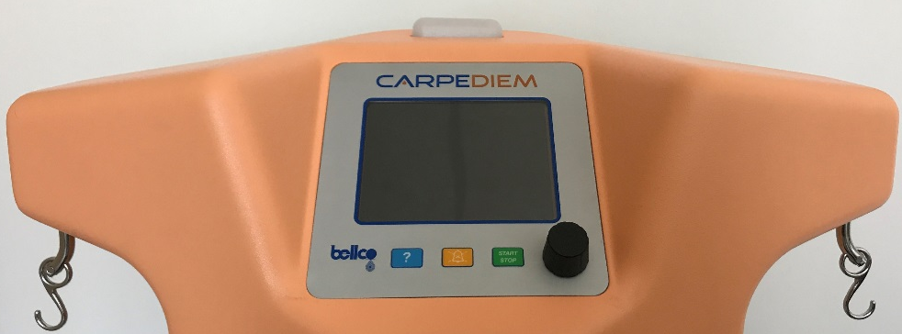
Carpediem™ system components
scales
Effluent scale
Infusion/dialysis scale
Fluid balance is controlled and managed by the infusion and effluent scales with a resolution of 1 gram
The maximum scale/weight capacity 2.4 Kg
Overview | Components | Disposables & consumables

Slide 17
Carpediem™ Components
Operating ranges
Weight loss: 0 to 2000 g
Weight loss accuracy: +30 grams in 24hrs
Max scale capacity: 2400 g
Treatment time: maximum treatment time
of 24 hrs; increments of 30 minutes
Effluent (EFF)
scale
Infusion/dialysis (INF/DIA) scale
Effluent pump
Infusion/dialysis (INF/DIA) pump
Blood pump
Overview | Components | Disposables & consumables

Slide 18
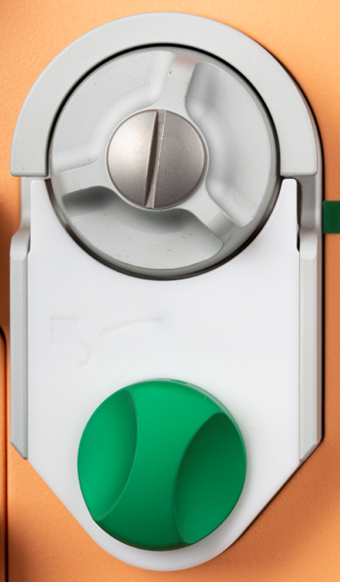
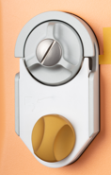
Carpediem™ system Components
Operating ranges
Blood pump flow rate: from 2 to 50 mL/min, resolution (increments) of 1 mL/min
Infusion/dialysate pump flow rate: 0 to 600 mL/h, resolution (increments) of 1 mL/min
Effluent pump flow rate: 0 to 900 mL/h, resolution (increments) of 1 mL/min
CVVH |  | CVVHD
HCD 015 Filter | From 0 to 4mL/min (0 to 240 mL/hr.) | HCD 015 Filter | From 0 to 10mL/min (0 to 600 mL/hr.)
HCD 025 Filter | From 0 to 10mL/min (0 to 600 mL/hr.) | HCD 025 Filter | From 0 to 10mL/min (0 to 600 mL/hr.)
NOTE: Weight loss flow is limited to maximum 20% of the blood flow
CVVH |  | CVVHD
HCD 015 Filter | From 0 to 4mL/min (0 to 240 mL/hr.) | HCD 015 Filter | From 0 to 14mL/min (0 to 840 mL/hr.)
HCD 025 Filter | From 0 to 10mL/min (0 to 600 mL/hr.) | HCD 025 Filter | From 0 to 15mL/min (0 to 900 mL/hr.)
NOTE: Effluent pump flow is limited to maximum 20% of the blood flow in (CVVH)
Overview | Components | Disposables & consumables

Slide 19
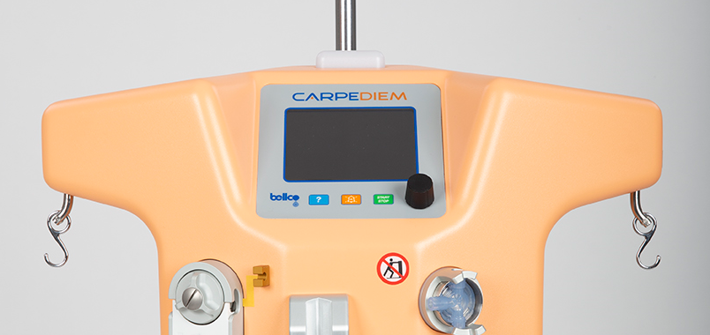
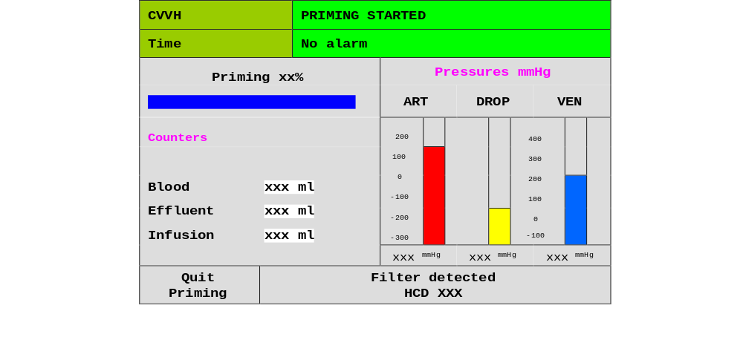
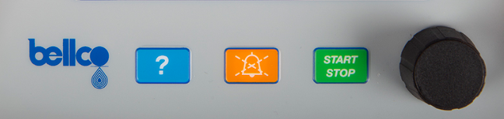
Carpediem™ System components
Machine Status & Alarms communication
A combination of simultaneous audible and visual cues communicate the state of the machine
The warning light will change color to communicate machine status or the priority of an alarm
A buzz will be heard during an alarm state
The message center will communicate information to the user before, during and after treatment
The help/information key ‘?’ provides information or direction on possible alarm causes as well as potential solution(s)
Warning light
Machine interface: Priming
Overview | Components | Disposables & consumables

Slide 20


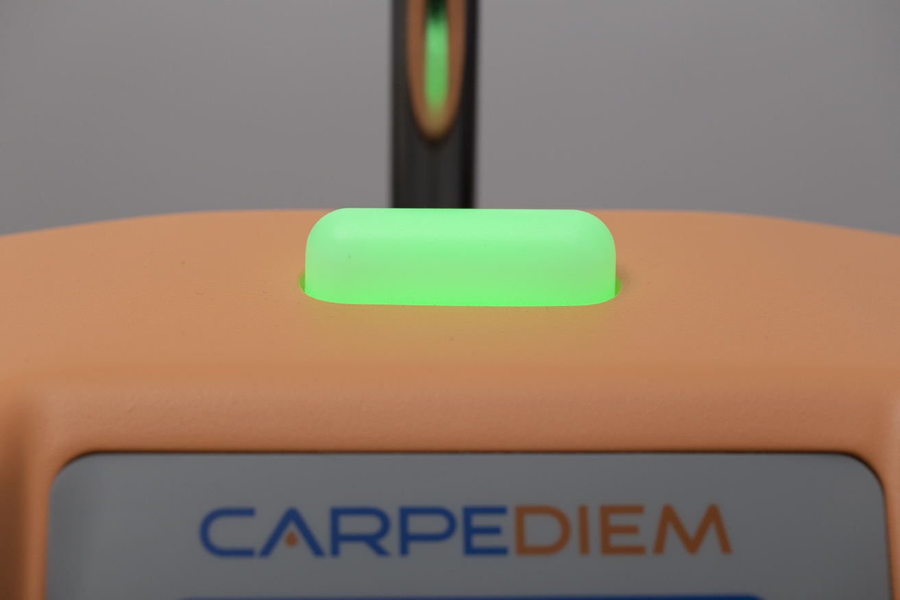
Carpediem™ System components
Alarm Color and priority
YELLOW and RED are used to define warning and alarm priorities
The blood pump may stop, slow or continue to operate depending on the alarm
Note: If more than one alarm state exists, the highest priority alarm will present first. Once the higher priority alarm has been resolved, the lower priority alarm will be shown
Message Color | Alarms identified | Results
Yellow 0.8 Hz | MEDIUM PRIORITY | Blood pump continues to operate; Tx running despite alarm
Red 1.6 Hz | HIGH PRIORITY | Blood pump stops or slows; Rapid intervention by operator required to correct issue or prevent coagulation of the blood circuit
Green light = NO alarm
Color and sound used to identify status conditions
Message class | Visual Signal | Audible Signal | Description
No Alarm | Green Continuous | Absent | Indicates that the equipment is in normal operating condition
Type I | Green Flashing | Absent | Indicates that the equipment is running a test (or an override) and does not require intervention by the operator
Type II | Green Flashing | Presents with a pulse every 15 sec | Indicates that the equipment has suspended the treatment and requires intervention by the operator
Overview | Components | Disposables & consumables

Slide 21
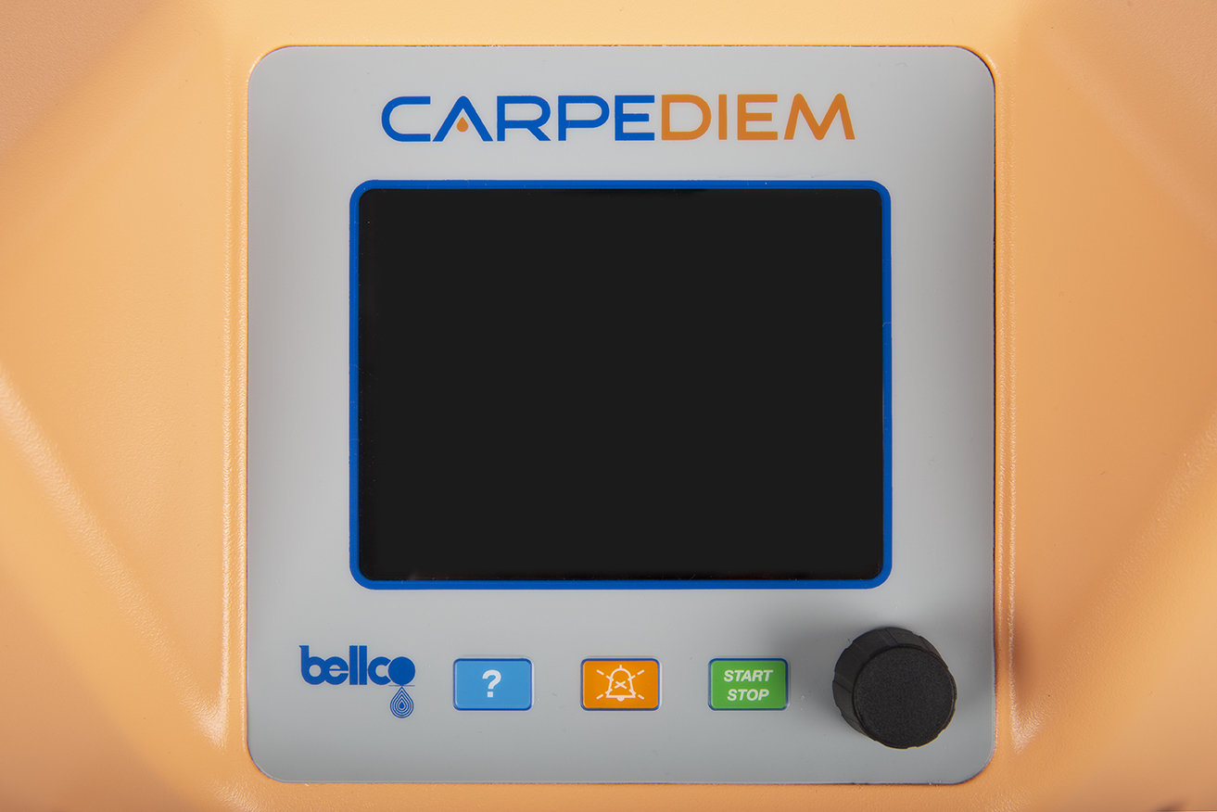
Carpediem™ system components
CONTROL PANEL
The control panel is used to set parameters and manage the operator interface
Help/information
button
Start/Stop
button
Alarm silence/reset
button
Adjustment and selection Knob
Overview | Components | Disposables & consumables

Slide 22
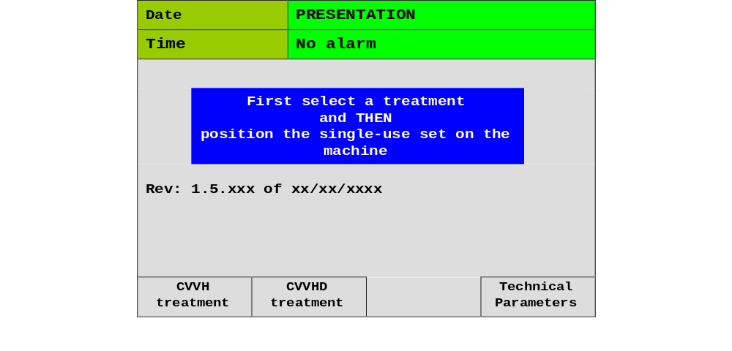
Carpediem™ System Components
Control Panel
Once initial testing completed, the operator MUST choose one of three available options:
OPTION 1 | OPTION 2 | OPTION 3
CVVH | CVVHD | Technical Parameters
Mode of therapy
Language, date,
time, display contrast
Note: a SCUF treatment can be performed selecting CVVH and then setting infusion volume to zero (0)
Note: Technical Parameters should be chosen the first time the machine is set up or language changed
Common Procedures | Adjunct Procedures

Slide 23
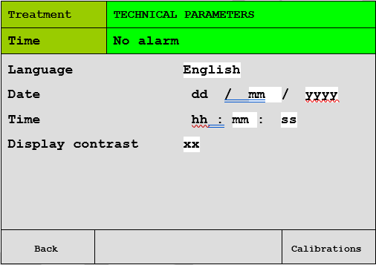
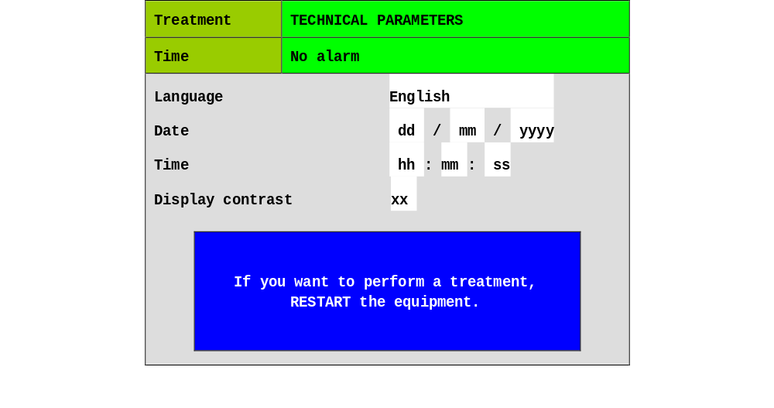
Carpediem™ System Components
Operator Interface
Modifiable fields have white backgrounds; fixed fields are grey
To modify a parameter, turn the knob on the display panel until the desired field background turns yellow
Press the knob to set the field highlighted
Turn the selection knob to the right or left to change the value
Press the knob once more to confirm/save the programming; background will turn blue following confirmation
English
Selected field
dd
hh
Modifiable fields
English
Confirmed field modification
Adjustment and selection knob
Note: the field background turns blue when parameter confirmed
Overview | Components | Disposables & consumables

Slide 24
Possible priming alarm
Scale weights do not read zero
If the alarms 15 EFFLUENT WEIGHT NOT ZERO occurs during the system preparation when a bag has been hung on EFF scale prior to installing the lines.
The scales must not have any weight on them on until the treatment mode has been selected
Remove the bags, reset or turn off and on machine using white ‘on/off’ key
15 EFFLUENT WEIGHT NOT ZERO
Alarms Management | Common Alarms | Emergency Procedures | Trouble Shooting

Slide 25
Possible priming alarm
Scale weights do not read zero
If the alarm 16 INF/DIA WEIGHT NOT ZERO occurs during the system preparation, infusion bags have been hung on the INF/DIA scale prior to installing the lines.
The scales must not have any weight on them on until the treatment mode has been selected
Remove the bags, reset or turn off and on machine using white ‘on/off’ key
16 INF/DIA WEIGHT NOT ZERO
Alarms Management | Common Alarms | Emergency Procedures | Trouble Shooting

Slide 26
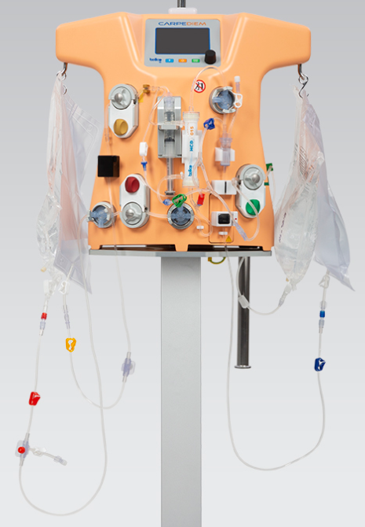
Possible priming alarm
Incomplete priming procedure
No one specific alarm
Check circuit installation
Check that the bags are properly positioned on their appropriate scales
Check that the return line (venous) is properly positioned in the air sensor
Check that the ultrafiltration line (effluent) is properly positioned in the BLD sensor
Check for air bubbles in the section of line monitored by the BLD sensor
Check pressure sensor functionality by slightly closing (manual clamping) sections of the circuit monitored by the sensors
Check which test did not pass:
    Protection relay test
    Pressurization test
Should the priming phase not complete, select End Priming and contact Technical services
Alarms Management | Common Alarms | Emergency Procedures | Trouble Shooting

Slide 27
Disposables & consumables

Slide 28
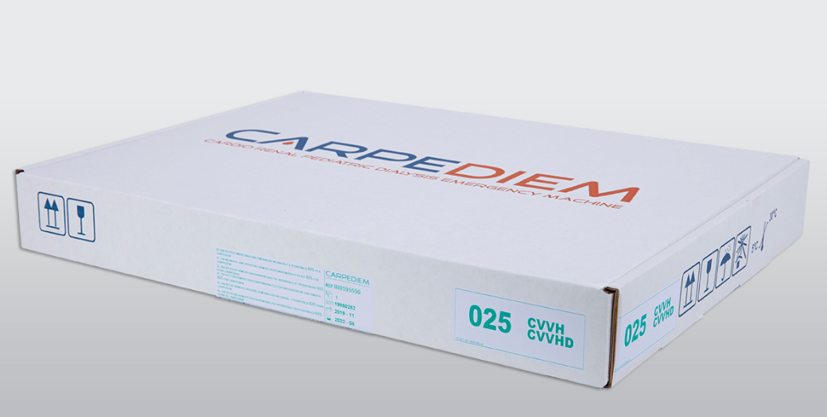
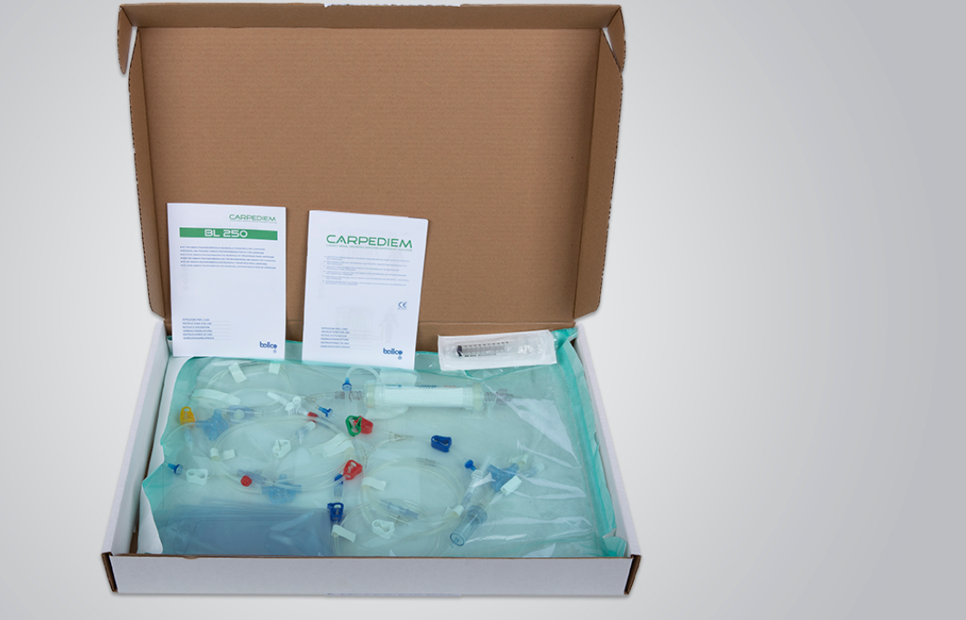
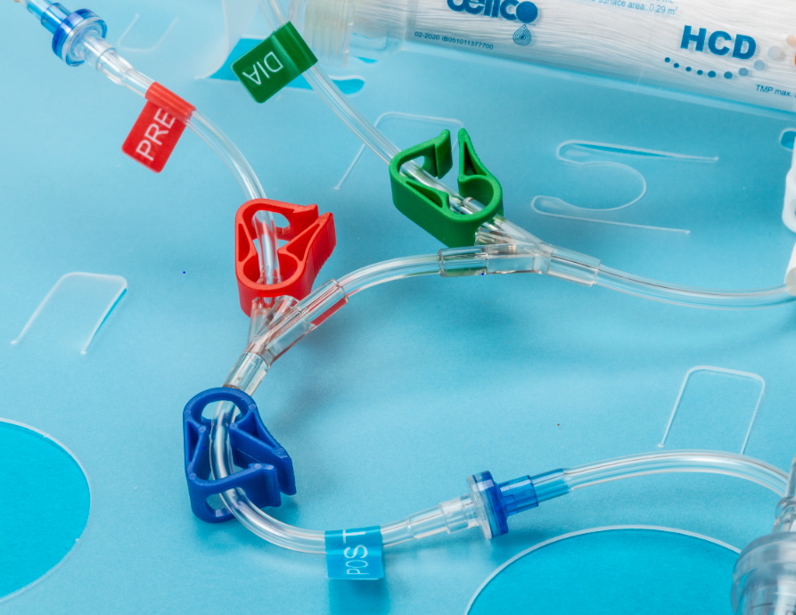
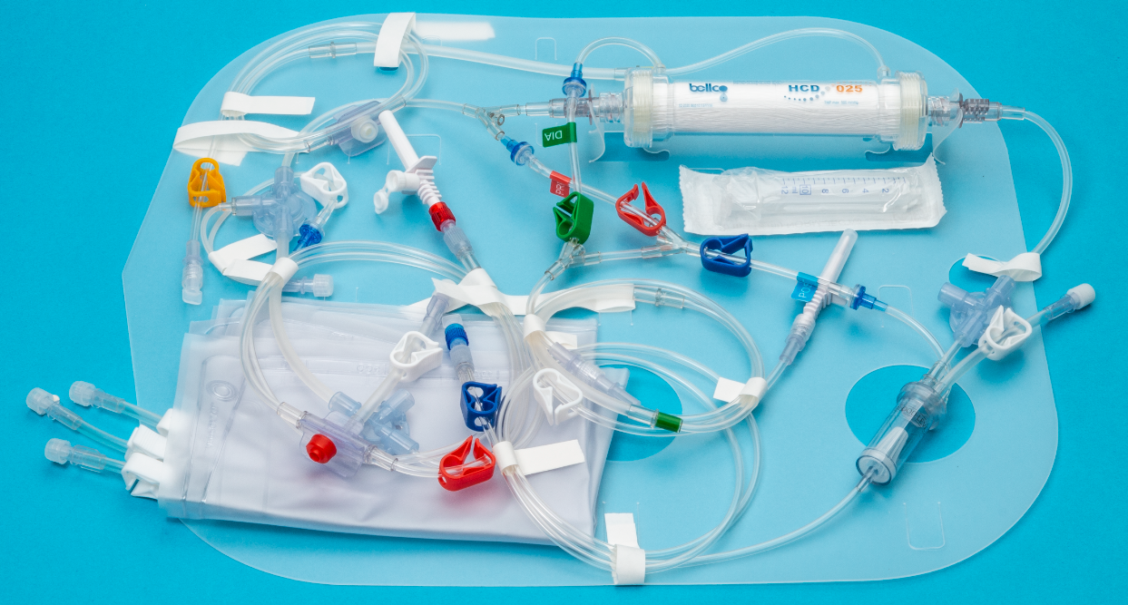
Carpediem™ system Disposables and Consumables
Carpediem™ Single-use kit
Carpediem™ Single-use Kit
Includes:
  Blood lines with attached dialyzer(filter)
    HCD 015 model
    or
    HCD 025 model
  3 X 3L sterile waste bags
  1 X 10 mL Syringe
  Single-use Kit IFU
  Preassembled Device IFU
Carpediem™ Single-Use kit
IFUs
Carpediem™ Single-Use
kit packaging
‘PRE’, ‘POST’ and ‘DIA’ labels
Dialyzer (filter)
10 mL syringe
Pressure dome
labels
label
Pressure dome
Waste bags
Pressure dome
Venous chamber
Overview | Components | Disposables & consumables

Slide 29
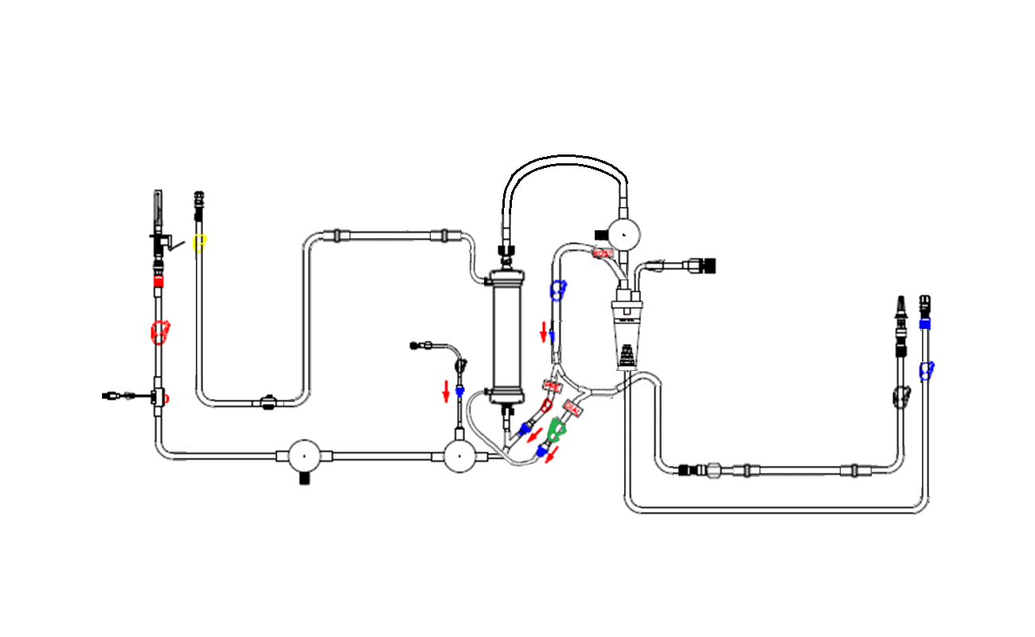
Carpediem™ system Disposables and Consumables
PREASSEMBLED BLOOD LINE SCHEMATIC
Arterial line Luer-lock
Effluent line Luer-lock
Venous pressure dome
Effluent pump segment
Venous return line sampling port
Effluent line
POST
Venous line Luer-lock
Infusion/dialysis line Luer-lock
Arterial supply line
Filter
Arterial line sampling port
Heparin pump line Luer-lock
Venous chamber
PRE
Infusion/dialysis pump segment
Heparin line
DIA
Arterial pressure dome
Pre-filter pressure dome
Blood pump segment
Venous return line
Overview | Components | Disposables & consumables

Slide 30
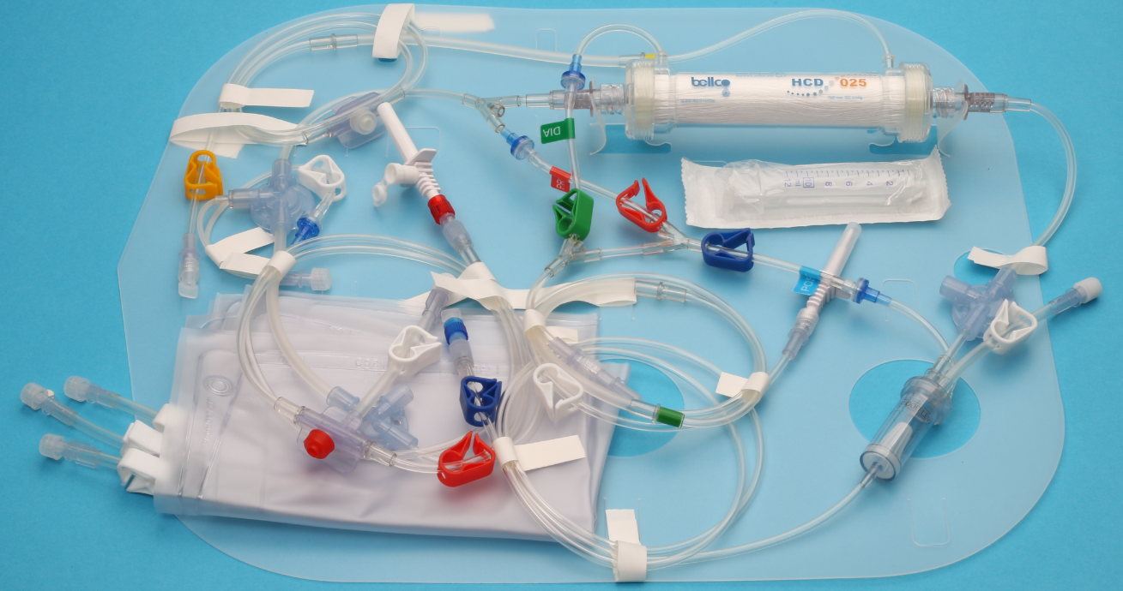
Carpediem™ system Disposables and Consumables
Disposable model Options
Preassembled device description | Filter Membrane material | Filter Surface (m²) | Preassembled Device Priming volume (mL) | Maximum Eff pump flow (mL/min) | Maximum EFF pump flow (mL/hr.) | Sterilization
015 CVVH/CVVHD | Polyethersulfone | 0.16 | 32 | 4 (CVVH) 14 (CVVHD) | 240 (CVVH) 840 (CVVHD | EtO
025 CVVH/CVVHD | Polyethersulfone | 0.29 | 41 | 10 (CVVH) 15 (CVVHD) | 600 (CVVH) 900 (CVVHD) | EtO
Overview | Components | Disposables & consumables

Slide 31
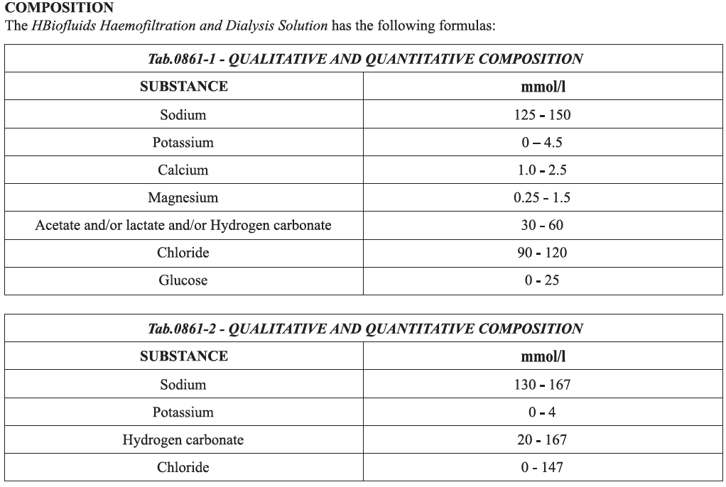
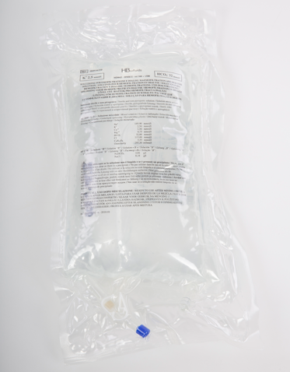
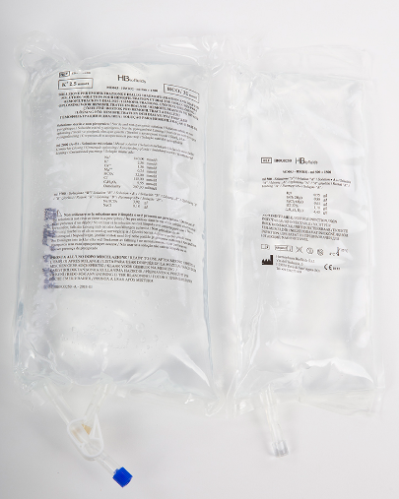
Carpediem™ System Disposables and Consumables
Consumable- dialysate fluid bag
Clear outer
packaging
Sterile solution
Two chamber bag
K 2.5 mmol/L
HCO3 of 32mmol/L
Na 140 mmol/L
Ca 1.5 mmol/L
Double chambered bag
Overview | Components | Disposables & consumables

Slide 32
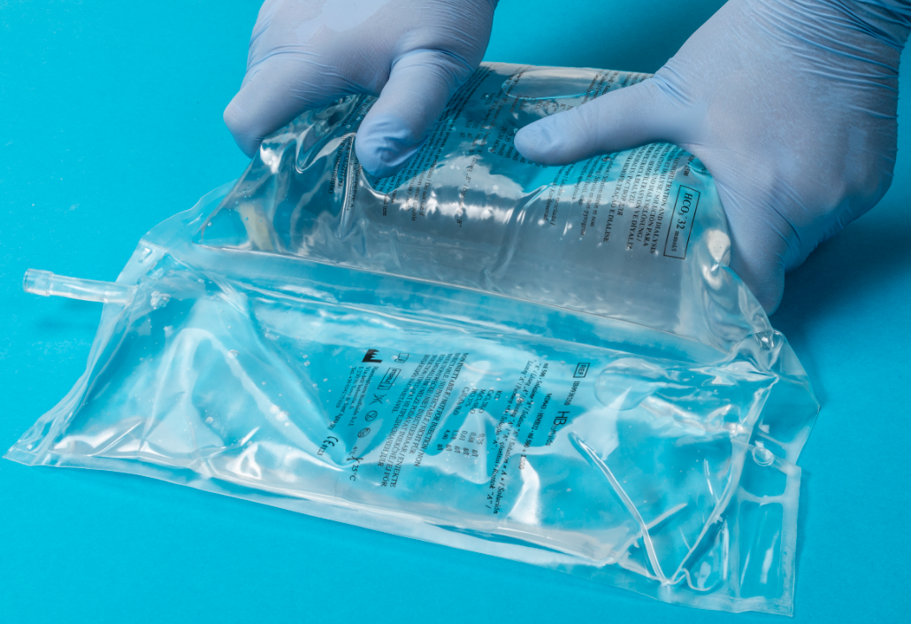
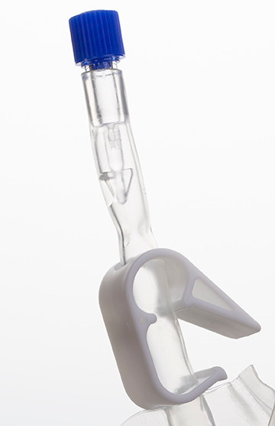
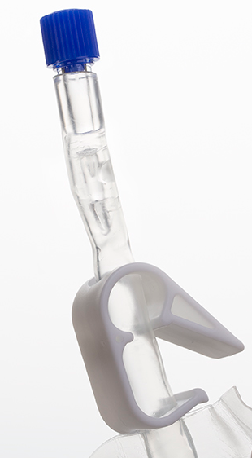
Carpediem™ system Disposables and Consumables
Consumable- dialysate fluid bag
Clear outer packaging
Breakable cone
18-month shelf life
Not for injection
Intact cone
Broken cone
Double chambered bag
Overview | Components | Disposables & consumables

Slide 33
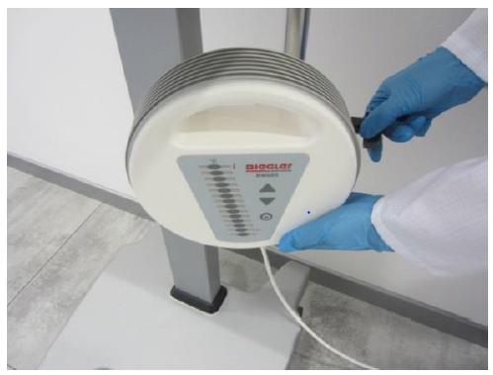



Carpediem™ system Components
Optional bIEGLER
warmer
Use of a warmer is optional
Set up prior to priming
Connects to the pole on the machine base plate
Requires dedicated disposable tubing
Connection to the preassembled device is made at the point of the infusion/dialysis line- not blood line
An equipopotential cord is required if the patient access is a CVC
Overview | Components | Disposables & consumables

Slide 34
Resources and Support

Slide 35
Clinical resources
Carpediem™ machine Operator’s Manual
Clinical procedure and trouble shooting resource
Access to a clinician

Slide 36
Emergency phone numbers
CLINICAL Support Phone Number 24/7 Accessibility
CLINICAL support: 24 hours a day, 7 days a week
1-800-255-6774
Select option 5
Select option 2
TECHNICAL Support Phone Number (Office hrs. 6AM-4PM PST)
TECHNICAL support: Monday-Friday 6AM-4PM PST
Calls received outside of office hours
directed to voicemail
A technical representative will return the
call within 2 hours the next business day
1-800-255-6774
Select option 5
Select option 1

Slide 37
ADDITIONAL Contacts
Non-Emergency Contact Information
CLINICAL Support: 24/7 Monday-Sunday
(All clinical support questions)
  Telephone: +1-800-255-6774; follow the prompts and selection options
  e-mail: rs.rcsclinicalsupport@medtronic.com
TECHNICAL Support: Office hours are Monday-Friday from 6AM-4PM PST
(Repair requests, service status, other non-emergency technical questions)
  Telephone: +1-800-255-6774; follow the prompts and selection options
  Fax: +1-760-603-5816
  e-mail: rs.serviceexperience@medtronic.com
CUSTOMER Service: Office hours Monday-Friday 8 AM- 6:30 PM EST
(Place an order, order status, tracking shipments)
  Telephone : +1-800-962-9888
  e-mail: rs.covidiencustomerservice@medtronic.com

Slide 38
References
  Bellco S.r.l. (2020). US Carpediem™ Operator’s Manual (rev 10). SW 1.5-0 IB5332941ENG
  Bellco S.r.l. (2019). CVVH and CVVHD Short Manual Carpediem (rev. 04). SW 1.5-0 IBSHM3001. Taken from Operator’s Manual IB5332941ENG Rev. 02 ed. 04/19.
  Bellco S.r.l.(2019). Single Use Kit Information For Use (rev.00). IB012002800
  Bellco S.r.l. (2020). Preassembled Device Information For Use. IB012002700
  Haemopharm Biofluids s.r.l.(2015). Hbiofluids Instruction For Use. Rev.01.
© 2020 Medtronic. All rights reserved. Medtronic, Medtronic logo and Further, Together are trademarks of Medtronic.
All other brands are trademarks of a Medtronic company. 06/2020 – US-RC-2000017

