Slide 1


Blood Bank & Transfusion Med
Stephanie Kinney, MD
Medical Director of Transfusion Services

Slide 2




Name that transfusion reaction?
Examples
4 mo old patient on TPN with congenital heart issues starts to develop shortness of breath 20 min into a transfusion of red blood cells
Drag each example on the right to the category below
15min after the completion of transfusion of a unit of platelets, a 15-year-old patient’s vital signs are: Temp 38.6C; Resp 14; Pulse 80; BP 110/65; DAT is negative
TACO – Transfusion Associated Circulatory Overload
Allergic
TRALI – Transfusion Related Acute Lung Injury
Febrile Non-hemolytic
5-year-old patient starts to develop itching and hives 15min into transfusion of a unit of plasma
15min after the completion of transfusion of a unit of platelets, a 15-year-old patient’s vital signs are: Temp 38.6C; Resp 14; Pulse 80; BP 110/65; DAT is negative
5-year-old patient starts to develop itching and hives 15min into transfusion of a unit of plasma
8-year-old patient develops shortness of breath 1 hour into transfusion of a unit of platelets. No noticeable improvement with diuretics, no prior volume issues
4 mo old patient on TPN with congenital heart issues starts to develop shortness of breath 20 min into a transfusion of red blood cells
8-year-old patient develops shortness of breath 1 hour into transfusion of a unit of platelets. No noticeable improvement with diuretics, no prior volume issues
Notes:
Answers:
4 mo old patient on TPN with congenital heart issues starts to develop shortness of breath 20 min into a transfusion of red blood cells – TACO
15min after the completion of transfusion of a unit of platelets, a 15-year-old patient’s vital signs are: Temp 38.6C; Resp 14; Pulse 80; BP 110/65; DAT is negative – Febrile Non-hemolytic
5-year-old patient starts to develop itching and hives 15min into transfusion of a unit of plasma – Allergic
8-year-old patient develops shortness of breath 1 hour into transfusion of a unit of platelets. No noticeable improvement with diuretics, no prior volume issues - TRALI

Slide 3
Name that transfusion reaction?
What should you do first if you suspect your patient is having a transfusion reaction?
Patient got pre-meds, so continue the transfusion
  Even if a patient gets pre-medications, they can still have transfusion reactions. You should always immediately stop the transfusion while you assess the patient. The only time you can restart a transfusion is if hives and/or itching are the ONLY symptoms, and the patient has been successfully treated with an appropriate dose of antihistamine. The decision to restart the transfusion MUST be made by the provider. In these cases you still need to fill out the transfusion reaction form and order the transfusion reaction workup in Epic to report the reaction to the blood bank, but blood samples are likely not necessary
Stop transfusion
  Correct answer – after stopping the transfusion, perform clerical re-check making sure patient info matches the info on the blood product, keep IV line open with normal saline, call the blood bank 6-4508, fill out the transfusion reaction form, order the transfusion reaction order set in Epic, and send the blood product with tubing and transfusion reaction form to the blood bank
Call blood bank and return the blood product with tubing
  Explanation – this is one of the next steps in working up a transfusion reaction, but the first step should always be to immediately stop the transfusion
Fill out the transfusion reaction form and order the Transfusion Reaction order set
  Explanation – this is one of the next steps in working up a transfusion reaction, but the first step should always be to immediately stop the transfusion
Review hospital policy BB.ADV.304 for additional information about transfusion reactions.

Slide 4
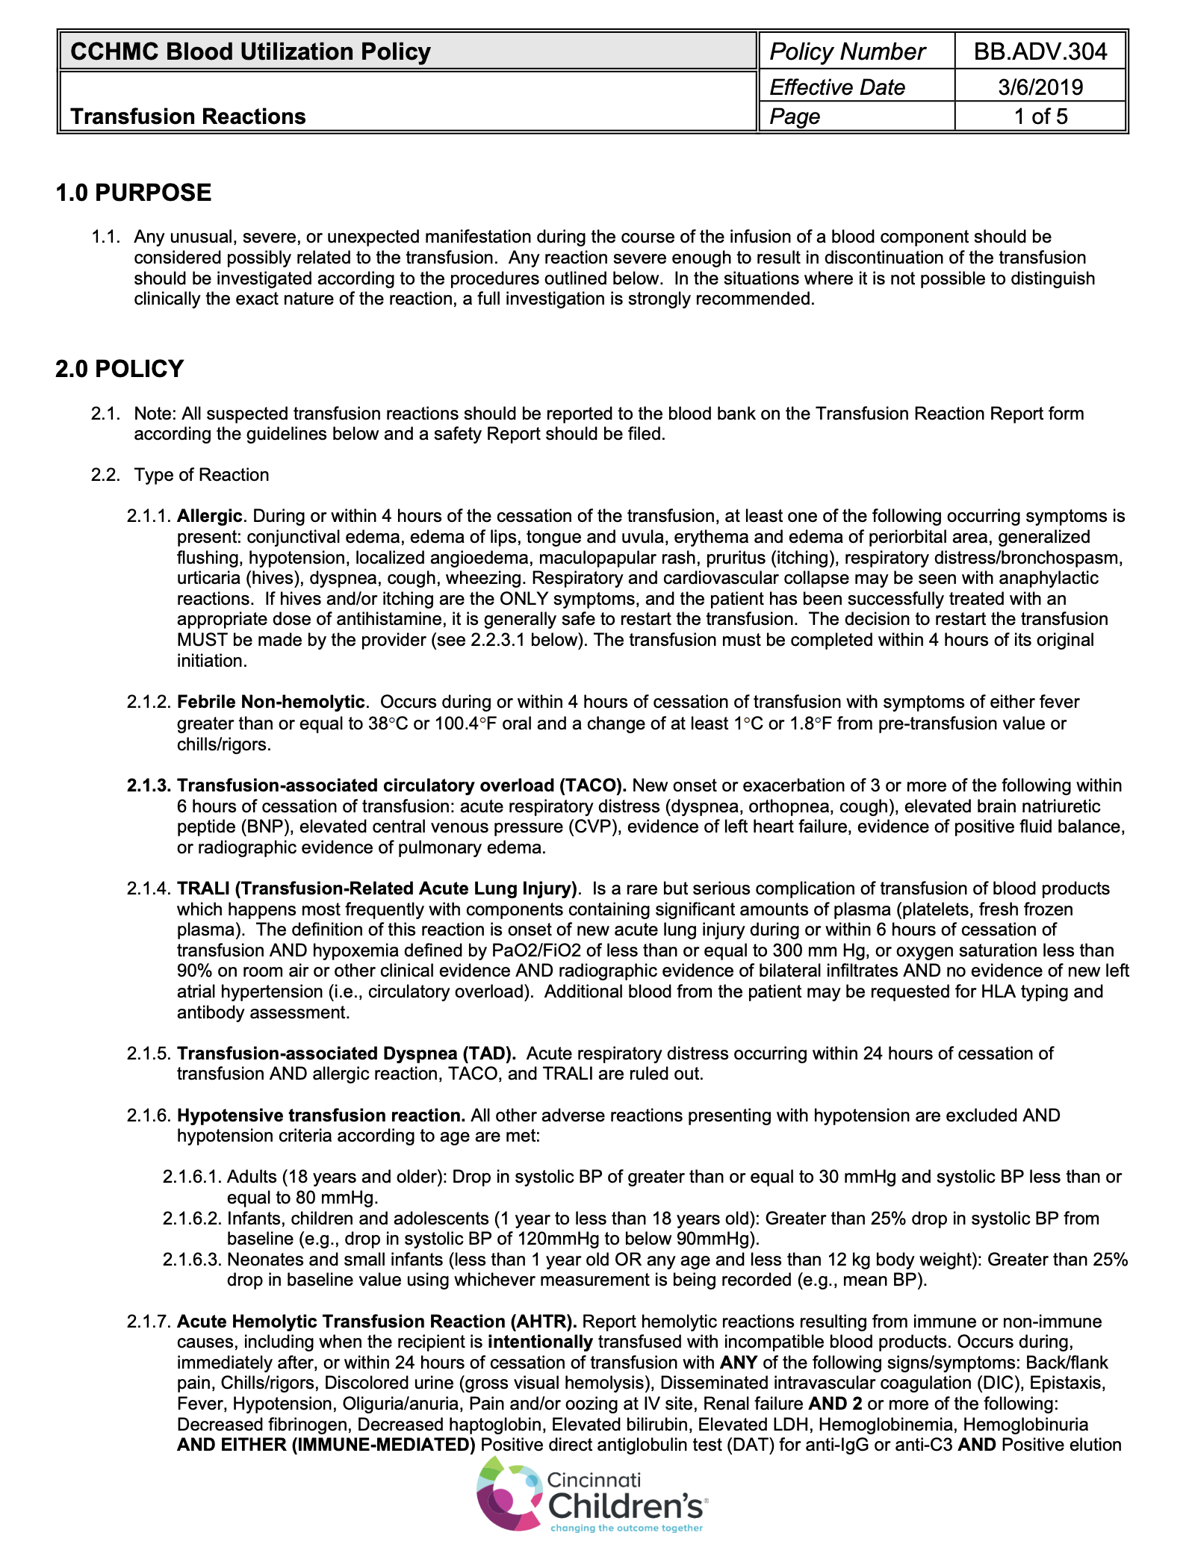

Slide 5
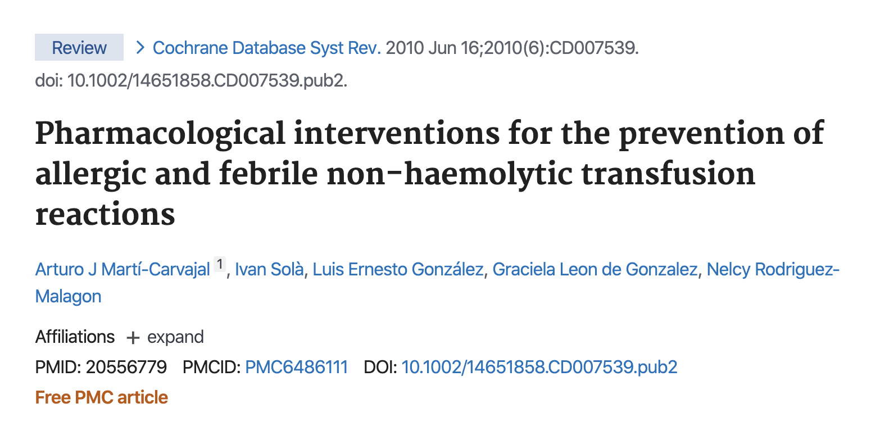
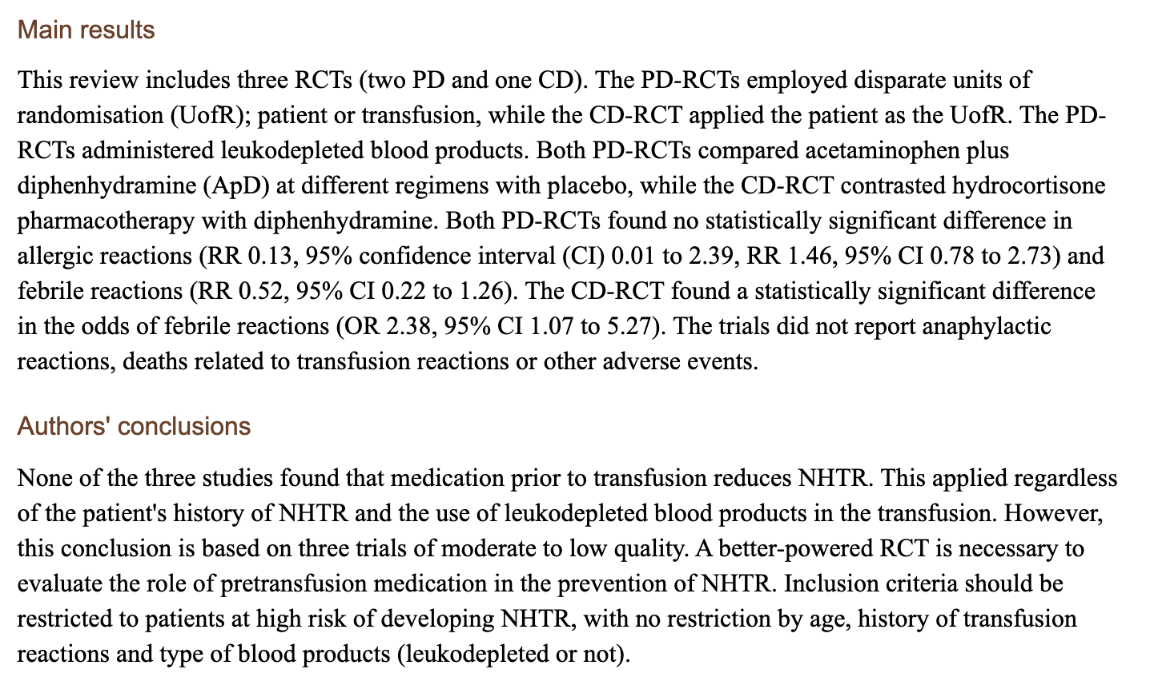
Should I pre-medicate before blood transfusion?

Slide 6
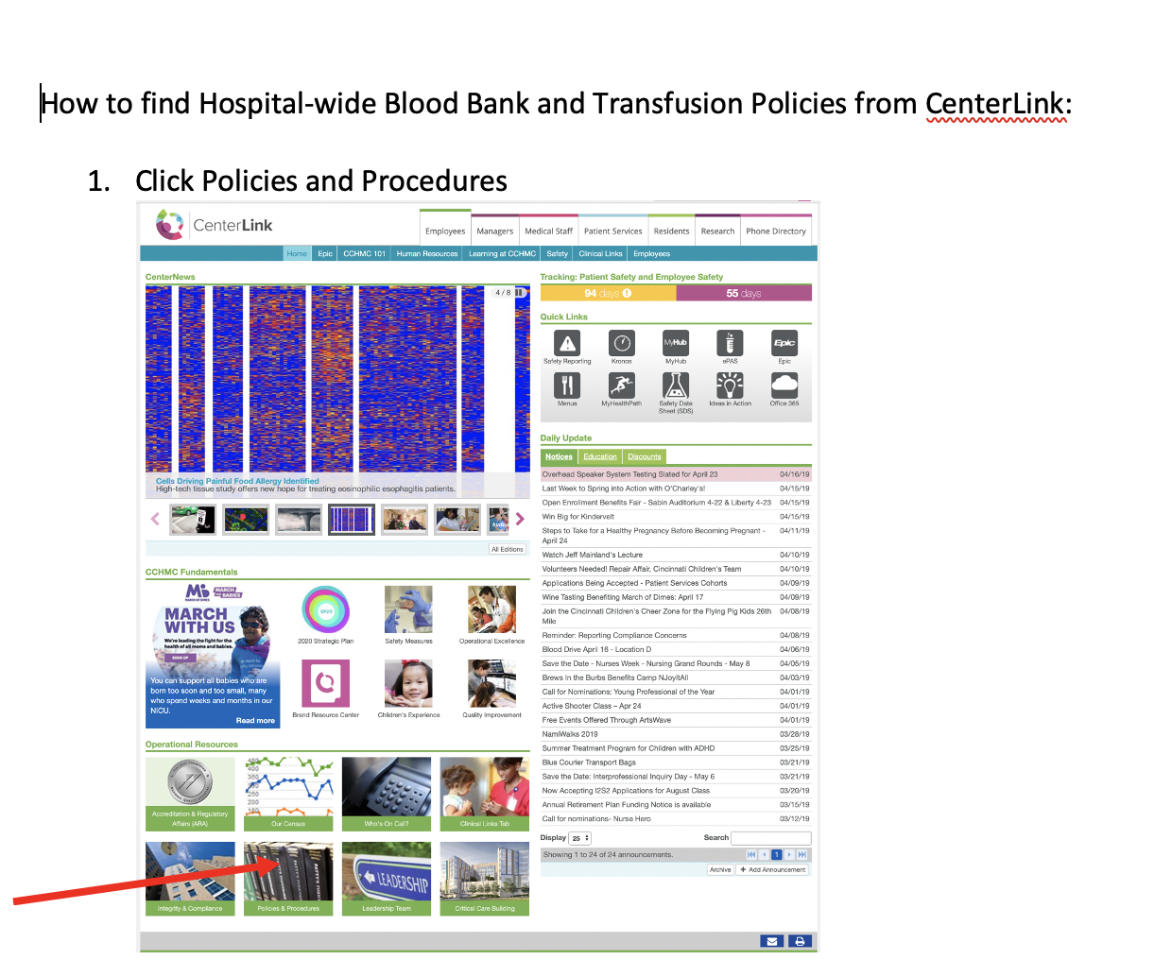
Hospital Transfusion Policies

Slide 7
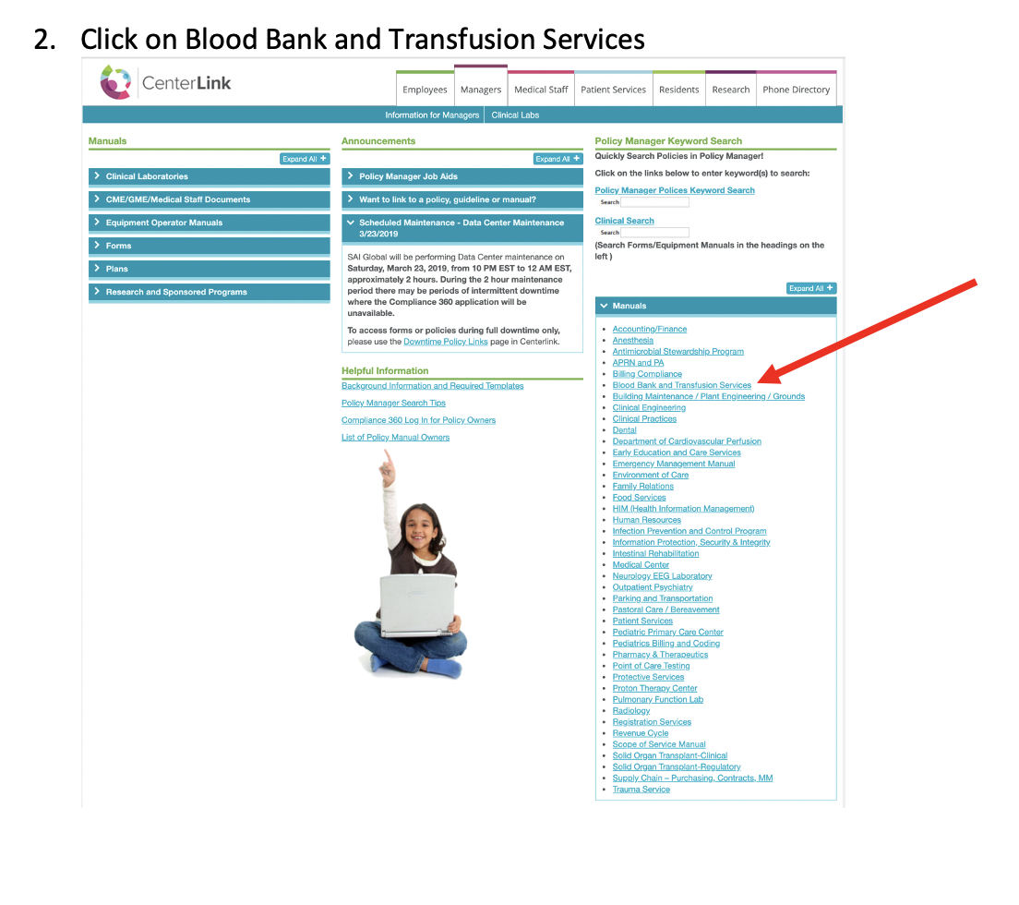

Slide 8
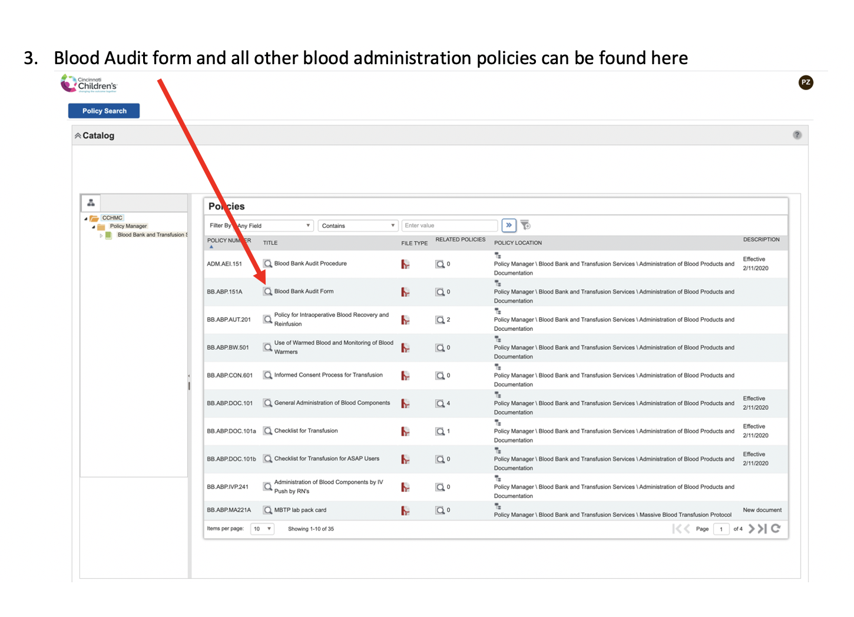

Slide 9
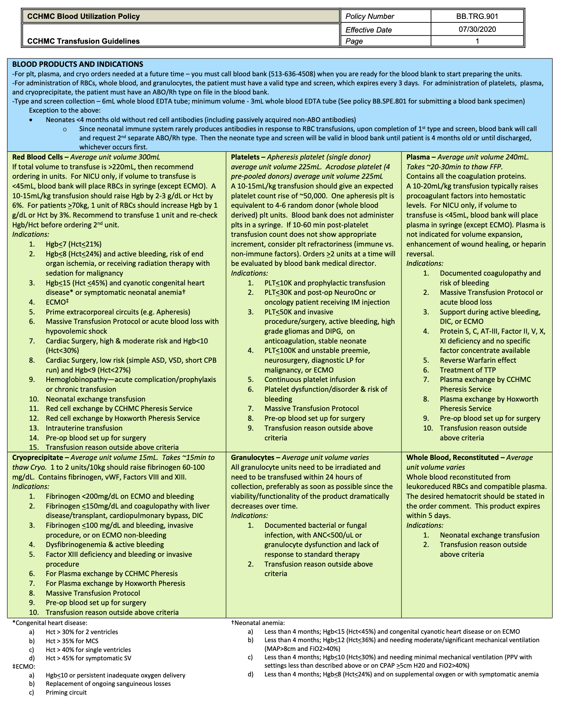

Slide 10
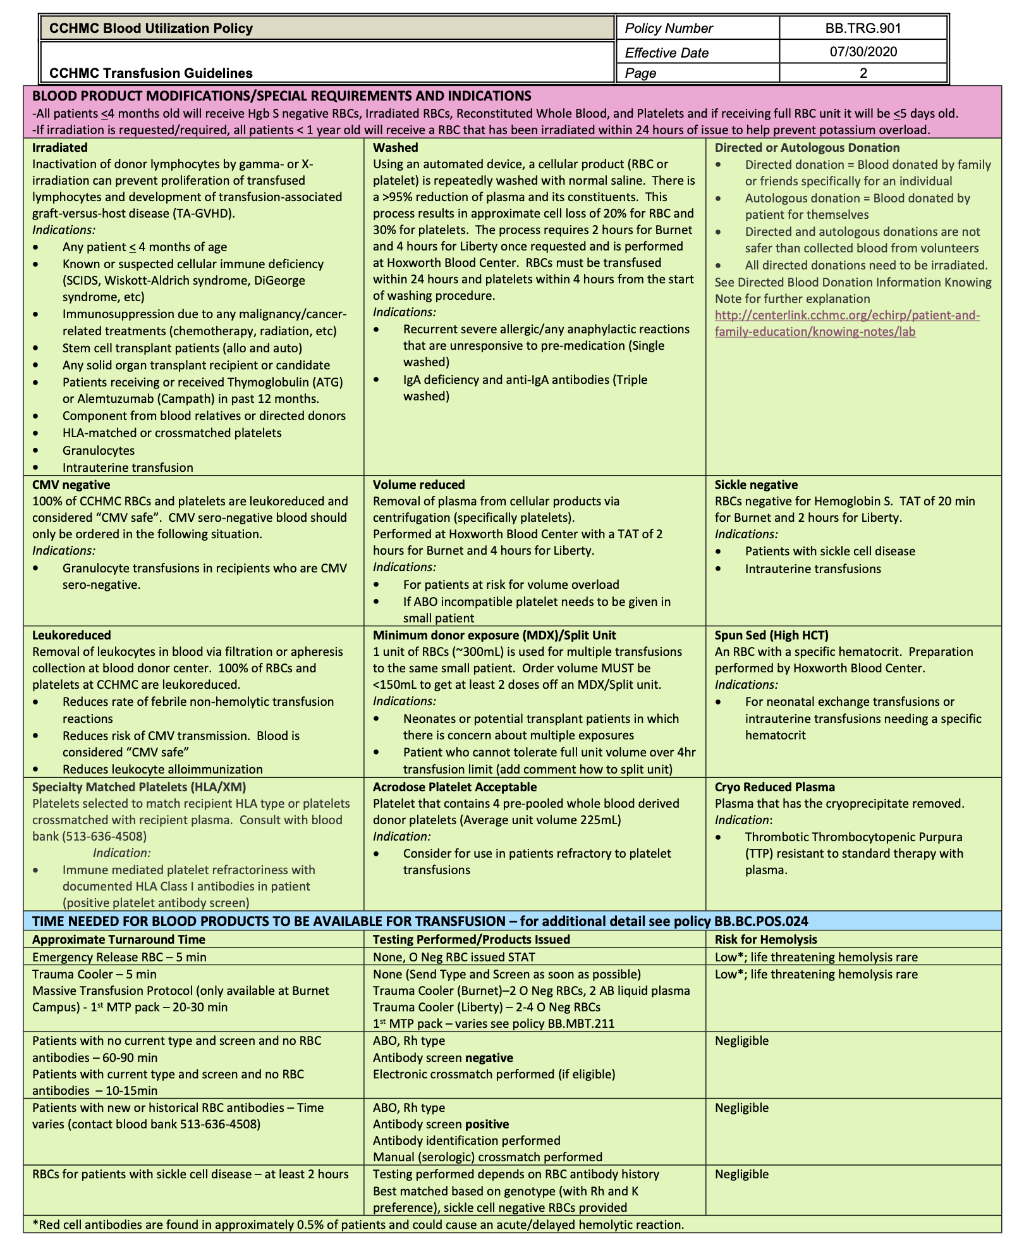

Slide 11
Blood ordering and administration- What should I do (or not do)?
Here is a list of things you should do or not do when ordering and administering blood products
Drag the items to categorize them as DOs or DON’Ts
I want to transfuse 350mL of RBCs so order in mL
My patient is actively bleeding but <20kg, so I order in mL
DOs
DON’Ts
I want to transfuse 350mL of RBCs so order 1 unit
I want to transfuse 350mL of RBCs so order in mL
I want to transfuse 350mL of RBCs so order 1 unit
I want to transfuse 215mL of platelets so I order in units
Consider the usual dose of RBCs and platelets in patients <20kg as 10-15mL/kg
My patient weighs 10kg so I order in units
Consider the usual dose of RBCs and platelets in patients <20kg as 10-15mL/kg
My patient is actively bleeding but <20kg, so I order in mL
I should order platelets to be given via gravity
Consider all blood products as colloid – which results in volume expansion
I should order platelets to be given via gravity
My patient weighs 10kg so I order in units
My patient has TPN that needs given at same time as blood, so keep infusing at its same rate
I want to transfuse 215mL of platelets so I order in units
My patient has TPN that needs given at same time as blood, so keep infusing at its same rate
Consider all blood products as colloid – which results in volume expansion
Notes:
I want to transfuse 350mL of RBCs so order in mL – DON’T – the average volume of a unit of RBC is ~300mL, once you are considering ordering close to or over 250mL strongly consider ordering a unit instead
I want to transfuse 350mL of RBCs so order 1 unit – DO - the average volume of a unit of RBC is ~300mL, once you are considering ordering close to or over 250mL strongly consider ordering a unit instead
Consider the usual dose in patients <20kg as 10-15mL/kg – DO
My patient weighs 10kg so I order in units – DON’T – Most routine transfusions in patients <20kg are ordered in mL and not units. The order set is programmed to take the patient’s weight into account to help decrease ordering errors (see screenshots next slide) This is to help prevent transfusion associated circulatory overload. The usual dose is 10-15mL/kg. Exceptions include when the product is ordered in cases of active bleeding, preparation for product to be given during a surgery or procedure, or preparation for a certain kind of circuit priming. You should note these indications in the blood prepare order. Cryoprecipitate also is an exception, as it only comes in units (average unit volume ~15mL). If the patient's ordered volume is >20mL/kg, nursing will be reaching out to the primary provider for confirmation.
Consider all blood products as colloid – which results in volume expansion – DO – If additional fluids are given during or around the time of transfusion, this increases the patient’s risk of volume overload.
My patient is actively bleeding but <20kg, so I order in mL – DON’T – If a patient is actively bleeding sometimes a unit of blood is the most appropriate order. Select this section on the order set (see screen shot)
I want to transfuse 215mL of platelets so I order in units – DO – The average volume of a unit of apheresis platelets is ~225mL. If you are considering ordering close to or more than 175mL of platelets, strongly consider ordering 1 unit instead.
I should order platelets to be given via gravity – DON’T - The following blood products can and should be transfused via infusion pumps which is the safest way to control volume transfused: RBCs, Platelets, Plasma, Cryoprecipitate
Granulocytes should NOT be given via infusion pump.
See policies:
BB.ABP.DOC.101 – General Administration of Blood Components
BB.ABP.SET.230 – Blood Administration Devices
My patient has TPN that needs given at same time as blood, so keep infusing at its same rate – DON’T -. If possible, no other fluids/medications should be infusing at same time as blood transfusion. However, if other fluids are necessary, consider the following during ordering process:
Is patient currently exhibiting or have a history of fluid sensitivity?
Is patient having signs and symptoms of fluid overload?
Will the patient have IVF or TPN infusing at the same time as the blood product transfusion?
If the answer is YES to any of the above questions:
Consider decreasing rate of continuous fluids (IVF and/or TPN)
Administer blood product over a longer period of time (not to exceed 4 hours per bag or syringe)
Administer a diuretic at the completion of the transfusion
NOTE: Normal saline is the only solution that may be mixed with or used to flush blood or blood components in the same lumen.

Slide 12
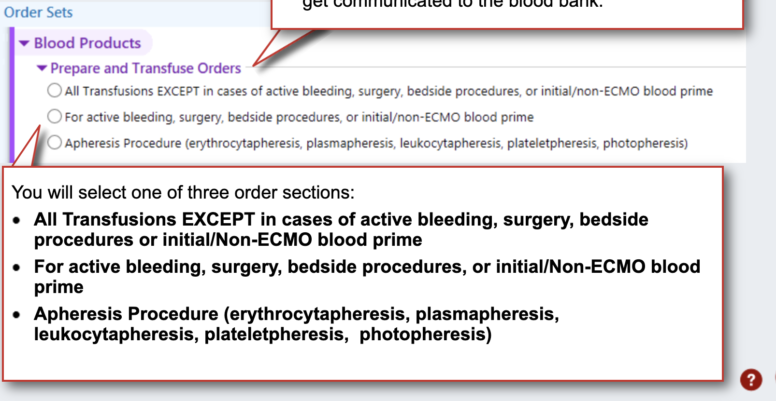
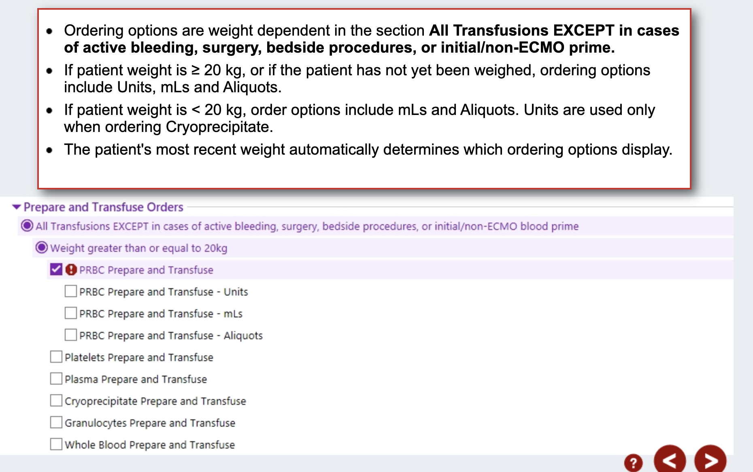
Most routine transfusions in patients <20kg are ordered in mL and not units.
The order set is programmed to take the patient’s weight into account to help decrease ordering errors (see screenshots next slide) This is to help prevent transfusion associated circulatory overload.
The usual dose is 10-15mL/kg.
Exceptions include when the product is ordered in cases of active bleeding, preparation for product to be given during a surgery or procedure, or preparation for a certain kind of circuit priming. You should note these indications in the blood prepare order.
Cryoprecipitate also is an exception, as it only comes in units (average unit volume ~15mL).
If the patient's ordered volume is >20mL/kg, nursing will be reaching out to the primary provider for confirmation.

Slide 13
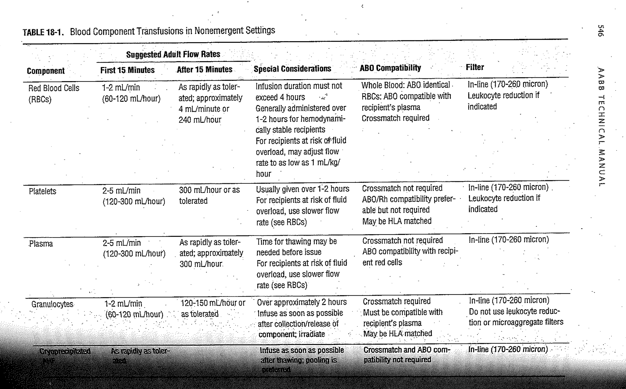
What rate should I use for transfusing?

Slide 14
What’s this pop up?
During ordering of a unit of RBCs for your non-emergent inpatient you see the following pop up…you should do the following things…
Select all that apply
Select “Order” type and screen
Select “Do Not Order” type and screen
Dismiss the pop up, it does not apply to this patient
Exit or suspend the orders and then obtain blood transfusion consent before coming back to the orders
Select blood consent to be obtained on pt arrival and do nothing else
If you see this BPA – you should always order the type and screen or your blood product will not be prepared by the blood bank. Also, all patients (except in emergency situations) need a valid blood consent on file prior to transfusing them.
Notes:
Correct answers 1 and 4. Explanation – This BPA pop up is alerting you that you are trying to order a blood product and there is no current (within the last 3 days) type and screen on your patient. This pop up is programmed to only pop up when necessary (including for babies <4mo old). The bottom part of this BPA is alerting you that there is not a valid blood consent on this patient and one needs to be obtained prior to transfusing the patient (only exception is emergency situations). Take home message: If you see this BPA – you should always order the type and screen or your blood product will not be prepared by the blood bank. Also, all patients (except in emergency situations) need a valid blood consent on file prior to transfusing them.

Slide 15
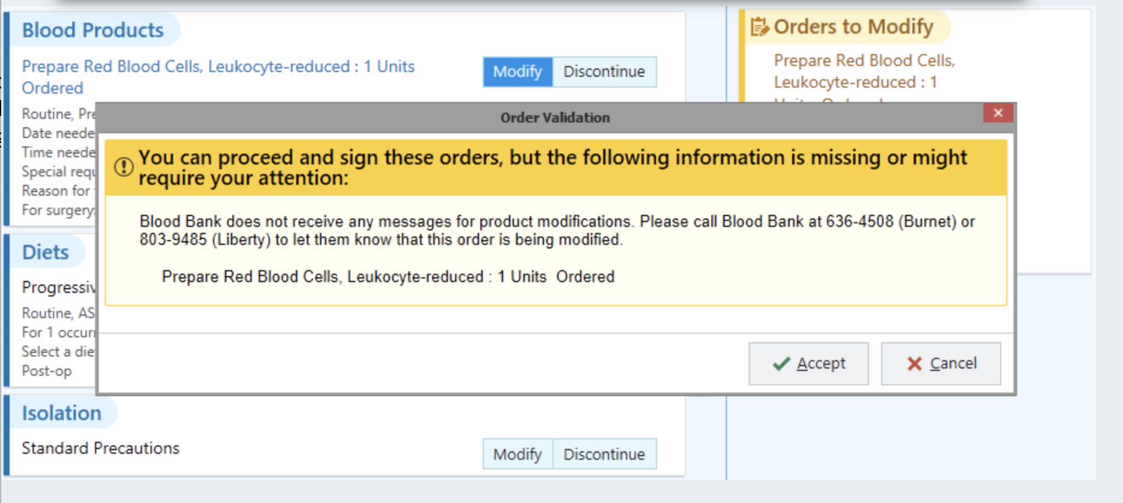
What’s this pop up?
After already placing an order for a unit of RBCs you need to modify something on both the prepare and transfuse order, you click to modify the orders and you see the following pop up…you should do the following things…
Select all that apply
1. Accept and proceed with modification
2. Cancel and just leave the order as is
3. Call the blood bank and ask if order can be modified
4. Call and notify the patient’s nurse only
5. If order can’t be modified place new order
Notes:
Correct answers: 3 & 5
When you attempt to modify or discontinue a blood product prepare or transfuse order, you will get a BPA pop-up alerting you to call the blood bank to let them know of the desired change. The blood bank computer system does not get blood product order updates via Epic.

Slide 16
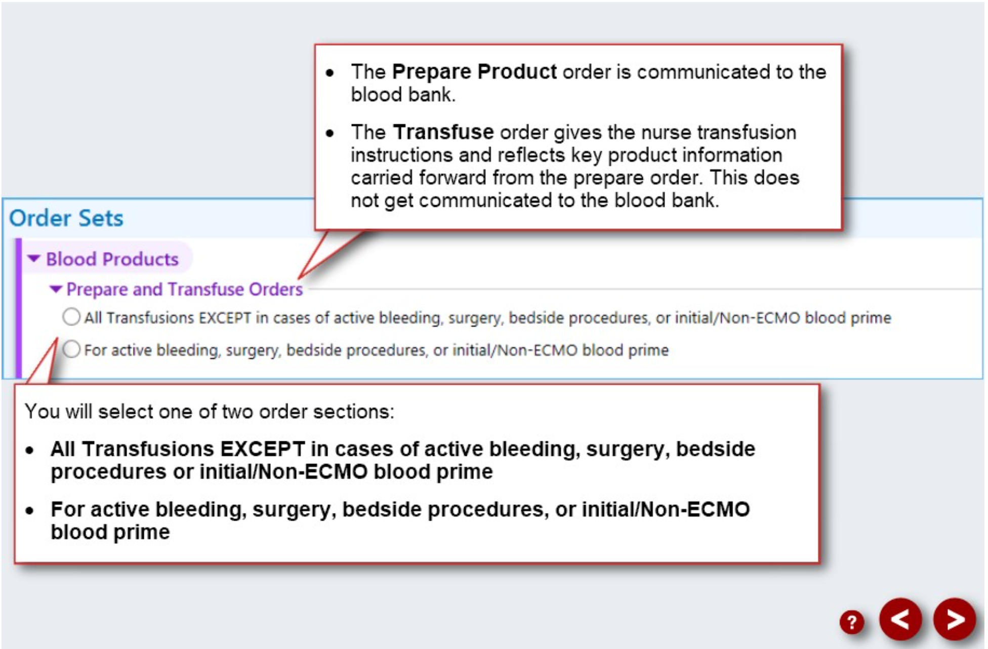
Prepare vs Transfuse Orders

Slide 17



I need blood NOW!
Examples
Patient in OR experiences some unexpected bleeding and the patient does not have a current type and screen. Only RBCs are needed at this time
Drag each example on the right to the category below
Patient comes to CCHMC ED as a Trauma STAT
Request the Trauma Cooler
Activate Massive Transfusion Protocol (MTP)
Trauma Cooler sent automatically
Request emergency released RBCs
Patient in PICU with rapid GI bleeding and needs both RBCs and Plasma w/in 5min
Patient already took the trauma cooler and bleeding isn’t controlled
Patient in OR experiences some unexpected bleeding and the patient does not have a current type and screen. Only RBCs are needed at this time
Patient in PICU with rapid GI bleeding and needs both RBCs and Plasma w/in 5min
Patient comes to CCHMC ED as a Trauma STAT
Patient already took the trauma cooler and bleeding isn’t controlled
Patient has received 4 units of RBCs w/in 1 hour and needs more
Patient has received 4 units of RBCs w/in 1 hour and needs more
Notes:
Answers:
Patient in OR experiences some unexpected bleeding and the patient does not have a current type and screen. Only RBCs are needed at this time – Request emergency released RBCs.
Patient comes to CCHMC ED as a Trauma STAT – Trauma cooler sent automatically
Patient in PICU with GI bleeding and needs both RBCs and Plasma w/in 5min – Request the trauma cooler
Patient already took the trauma cooler and bleeding isn’t controlled – Activate Massive Transfusion Protocol (MTP)
Patient has received 4 units of RBCs w/in 1 hour and needs more - Activate Massive Transfusion Protocol (MTP)

Slide 18
I need blood NOW!
True/False
  Blood bank will send the blood requested in emergencies to me
    Correct answer is False
    Explanation: The blood bank is busy preparing the blood products for the emergency. In all situations except for a Trauma STAT arriving in the ED, you must send someone from the floor to pick up the blood products from the blood bank
  I request emergency released RBCs, the trauma cooler, and active a massive transfusion protocol via Epic
    Correct answer is False
    Explanation: Emergency released RBCs, the trauma cooler, and activation of a massive transfusion protocol are requested/activated by immediately calling the blood bank 6-4508. Blood product orders are not necessary in these emergency situations. The blood bank enters these orders directly into their computer system which then display in Epic.
Notes:
Blood bank will send the blood requested in emergencies to me
Correct answer is False
Explanation: The blood bank is busy preparing the blood products for the emergency. In all situations except for a Trauma STAT arriving in the ED, you must send someone from the floor to pick up the blood products from the blood bank
I request emergency released RBCs, the trauma cooler, and active a massive transfusion protocol via Epic
Correct answer is False
Explanation: Emergency released RBCs, the trauma cooler, and activation of a massive transfusion protocol are requested/activated by immediately calling the blood bank 6-4508. Blood product orders are not necessary in these emergency situations. The blood bank enters these orders directly into their computer system which then display in Epic.

Slide 19
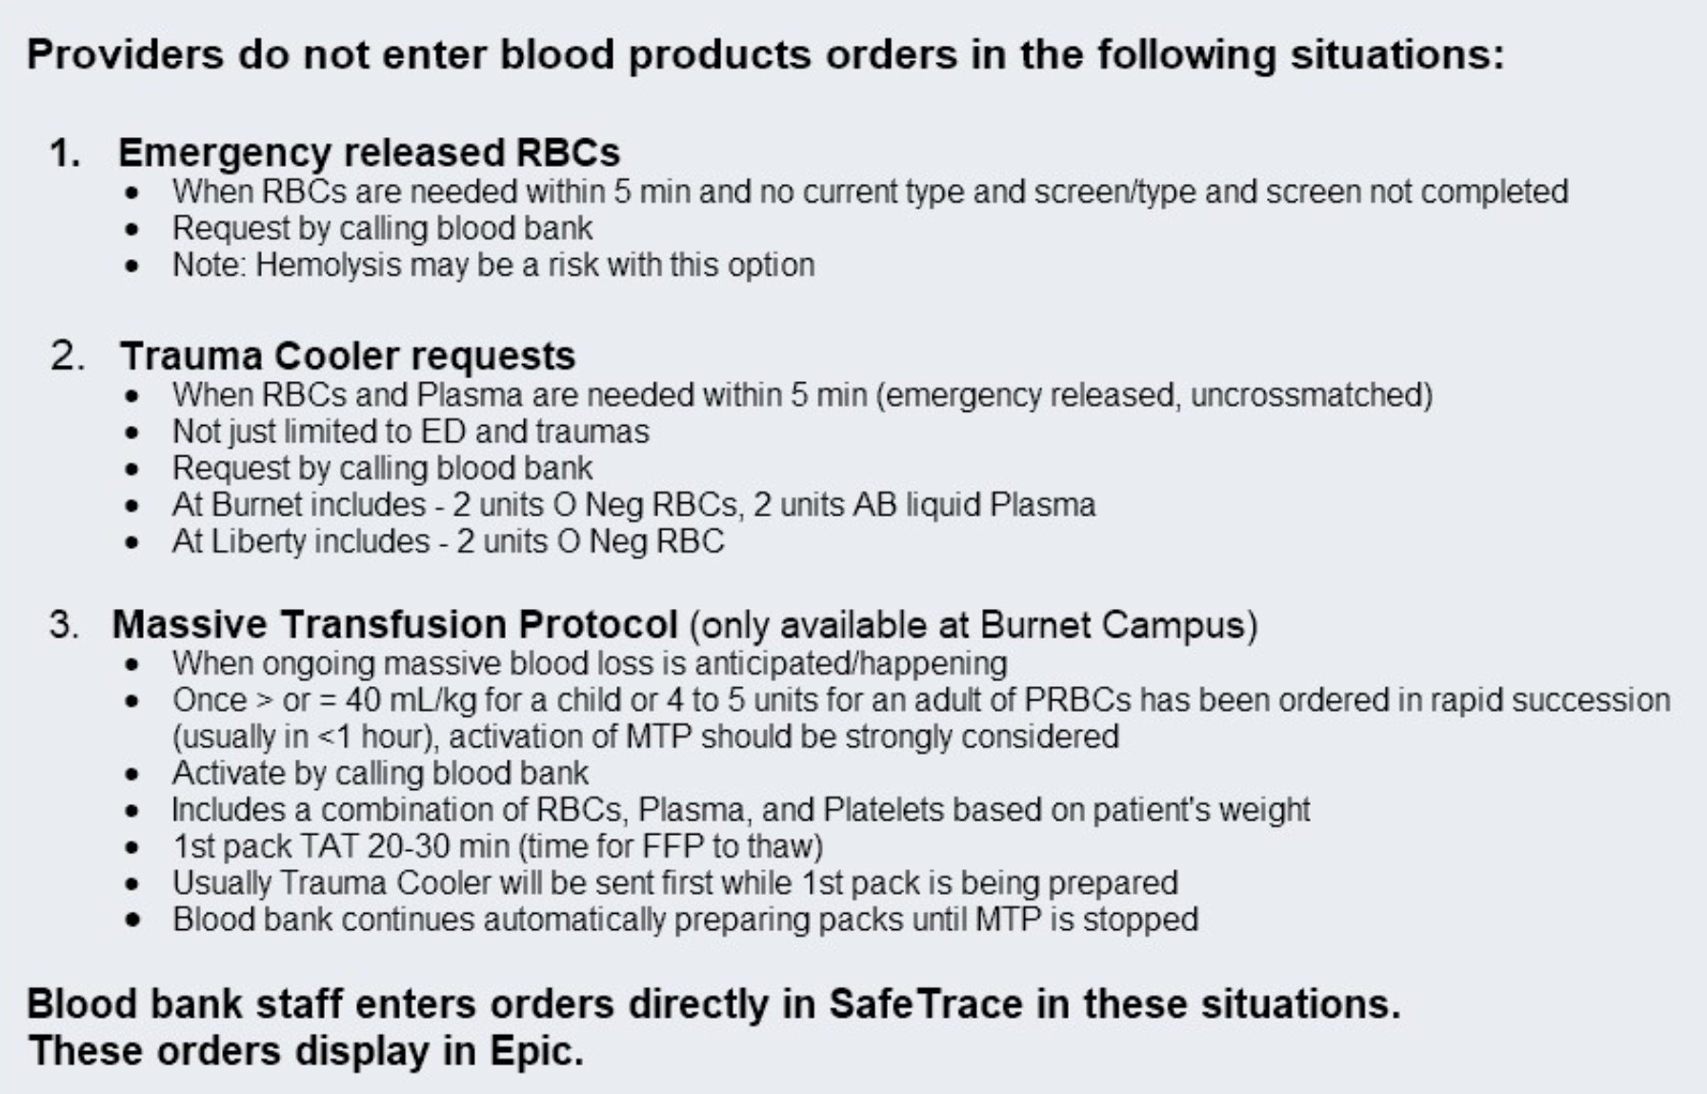
I need blood NOW!

Slide 20

Questions??

